Slide 1
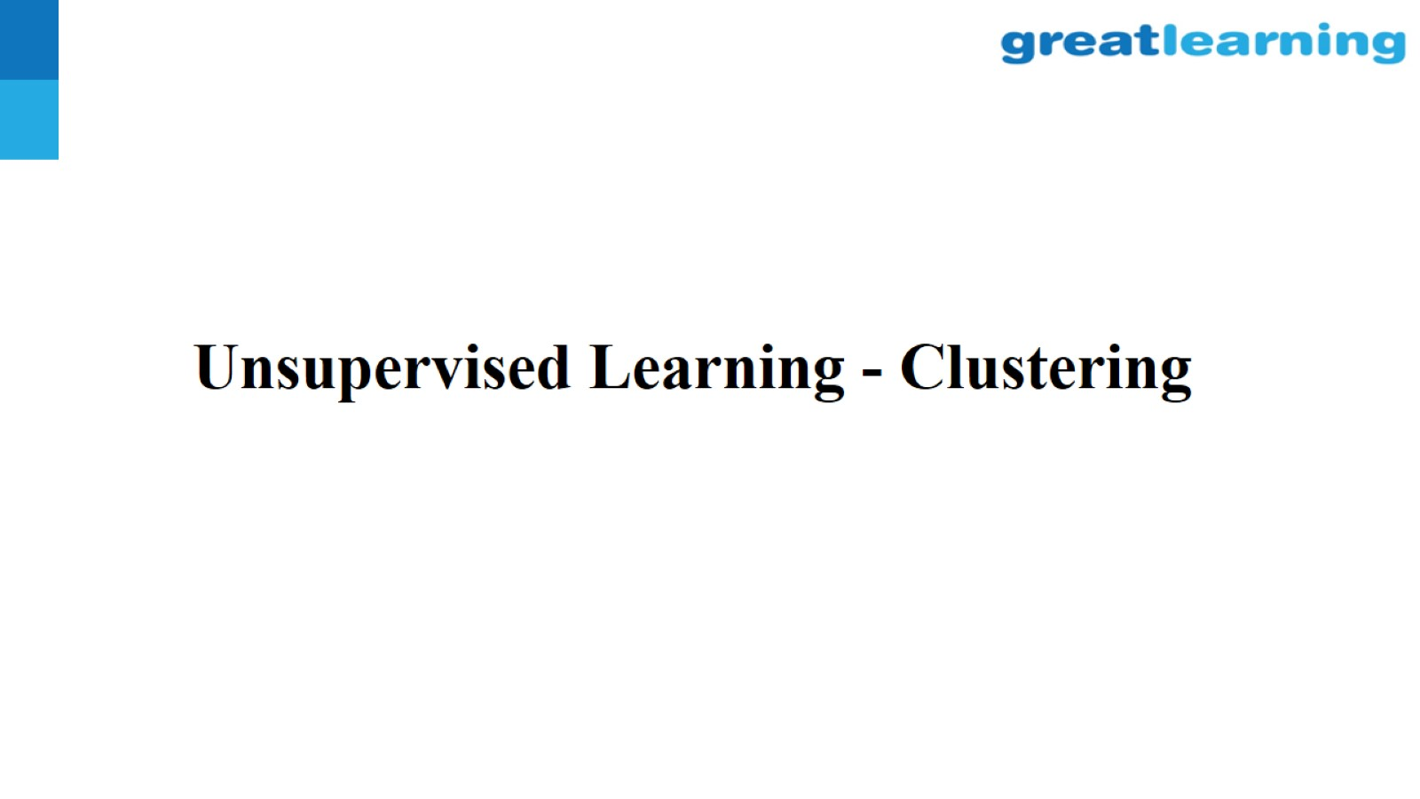
Unsupervised Learning - Clustering

Slide 2
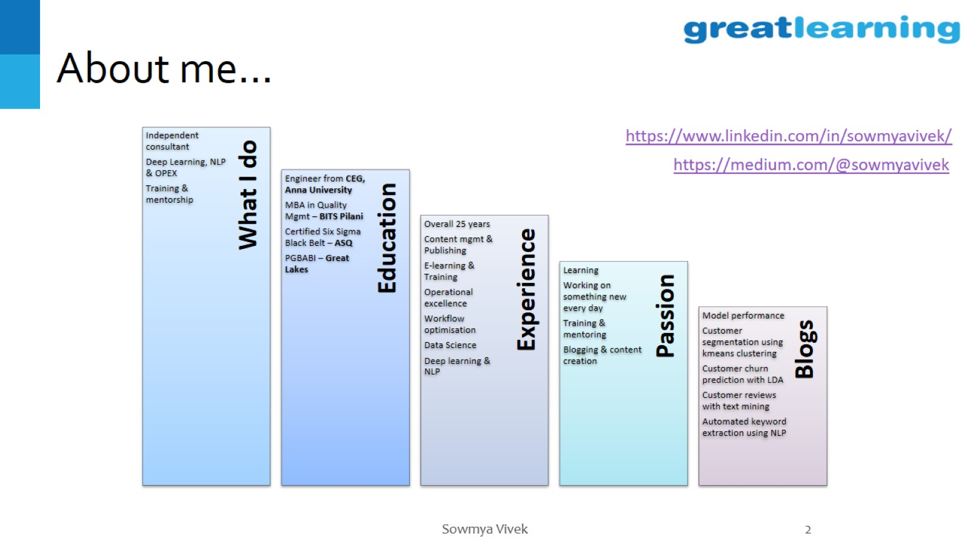
About me…

Slide 3
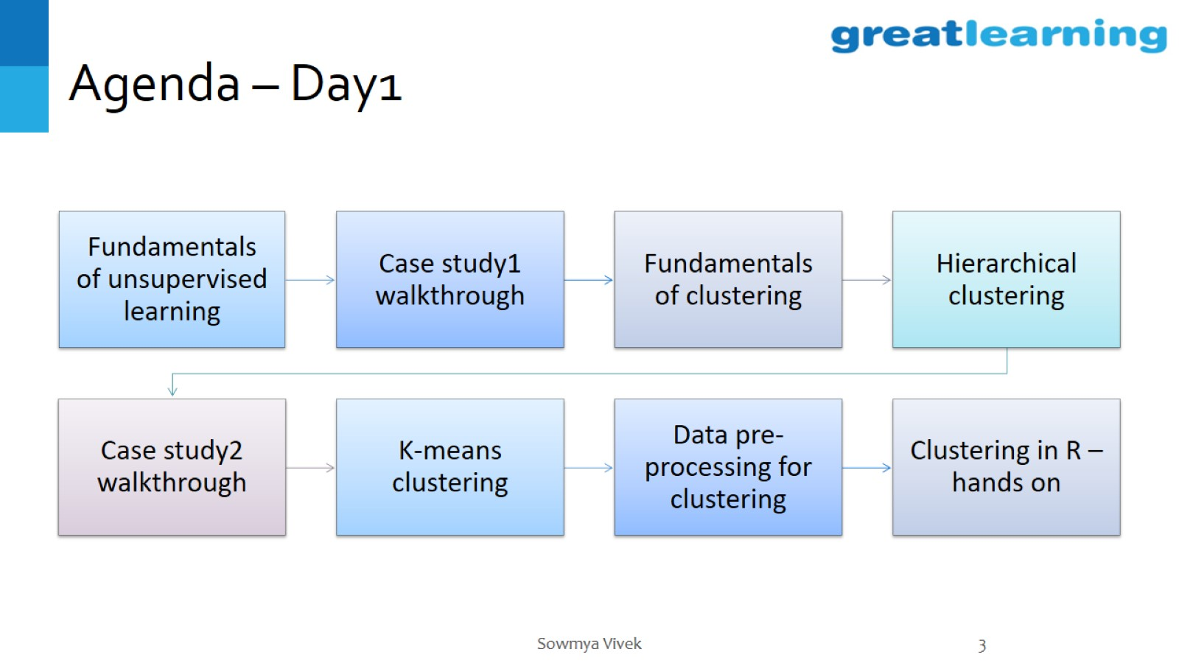
Agenda – Day1

Slide 4
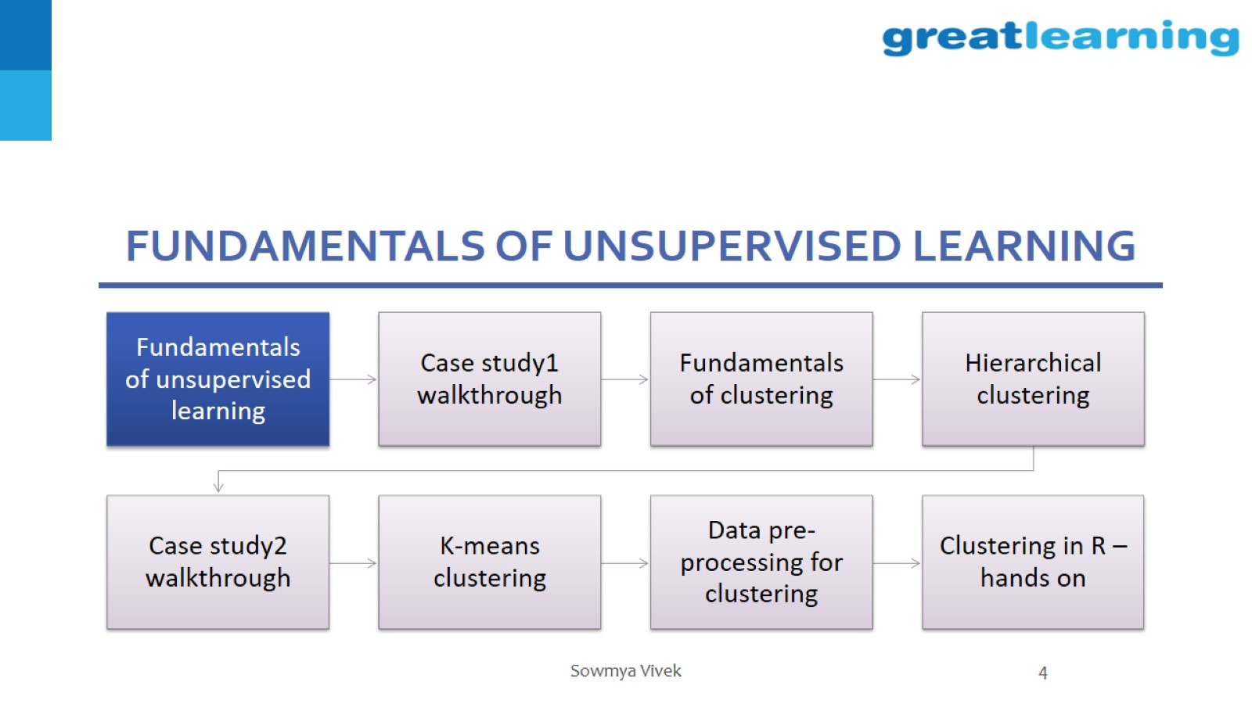
Fundamentals of unsupervised learning

Slide 5
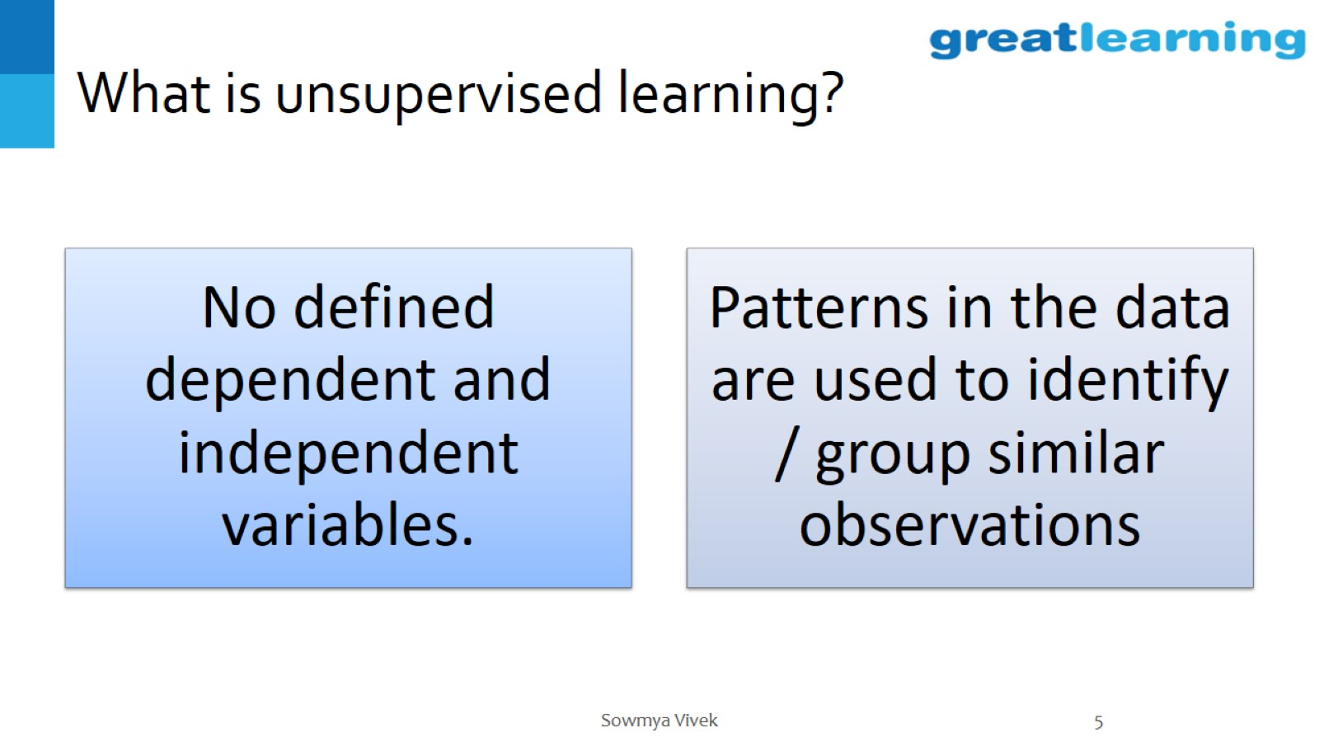
What is unsupervised learning?

Slide 6
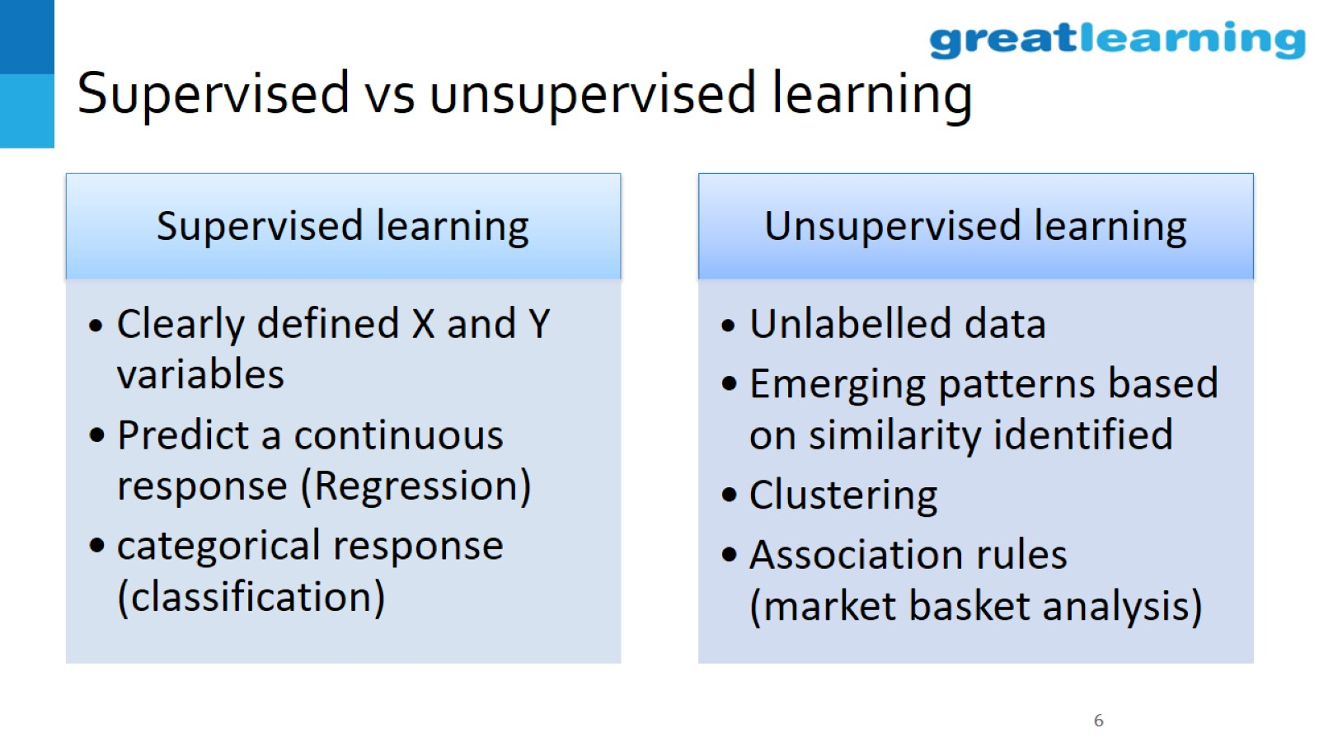
Supervised vs unsupervised learning

Slide 7
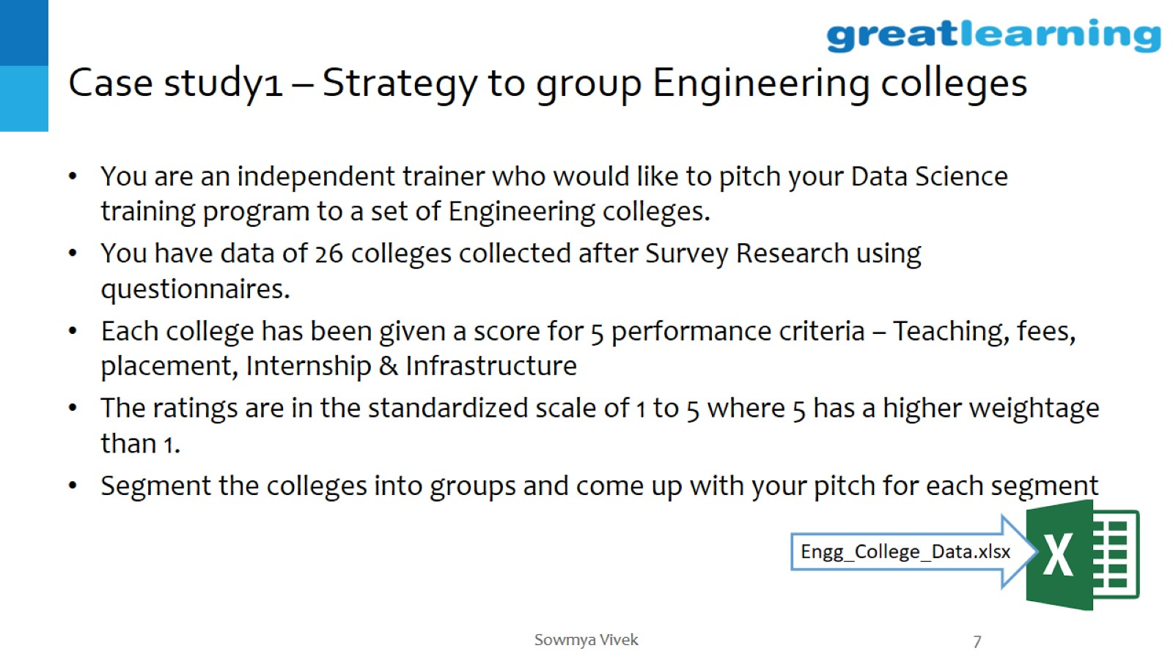
Case study1 – Strategy to group Engineering colleges

Slide 8
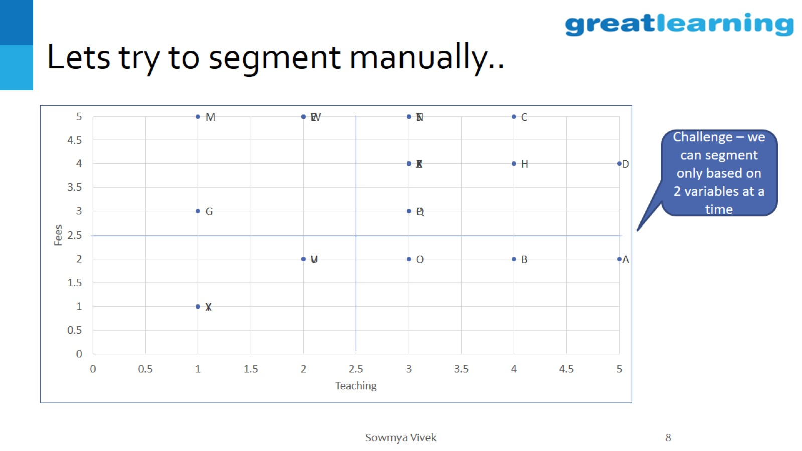
Lets try to segment manually..

Slide 9
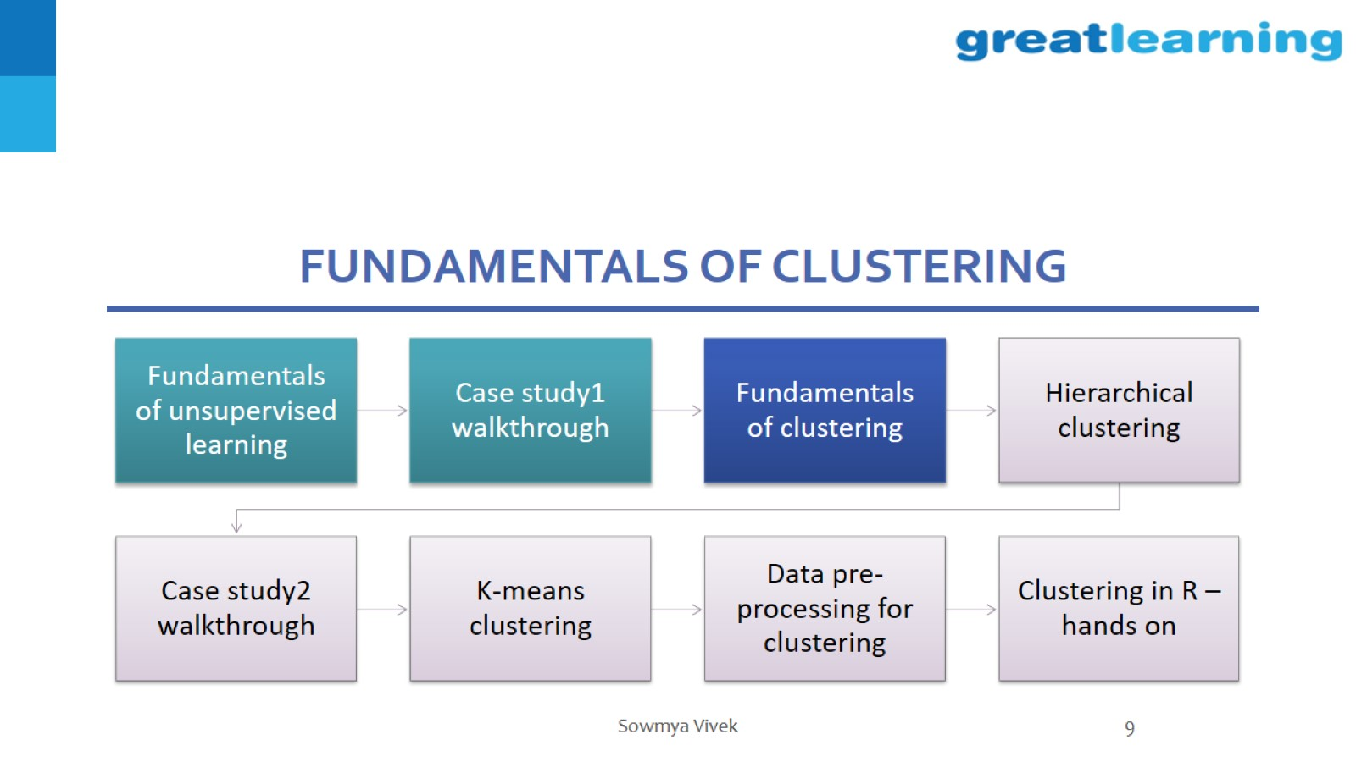
Fundamentals of clustering

Slide 10
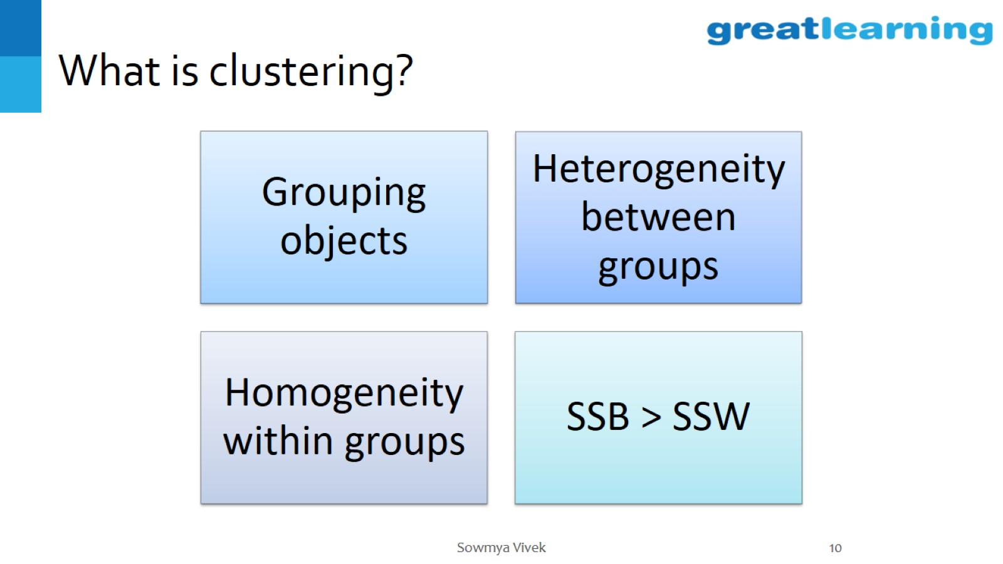
What is clustering?

Slide 11
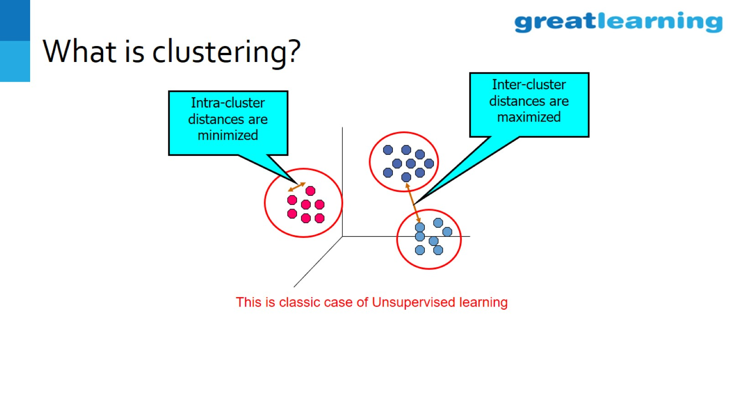
What is clustering?

Slide 12
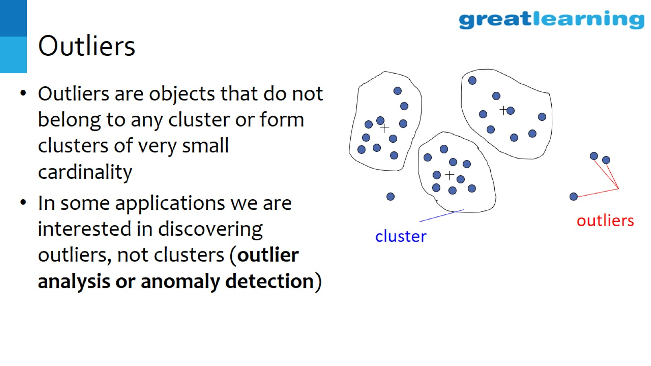
Outliers

Slide 13
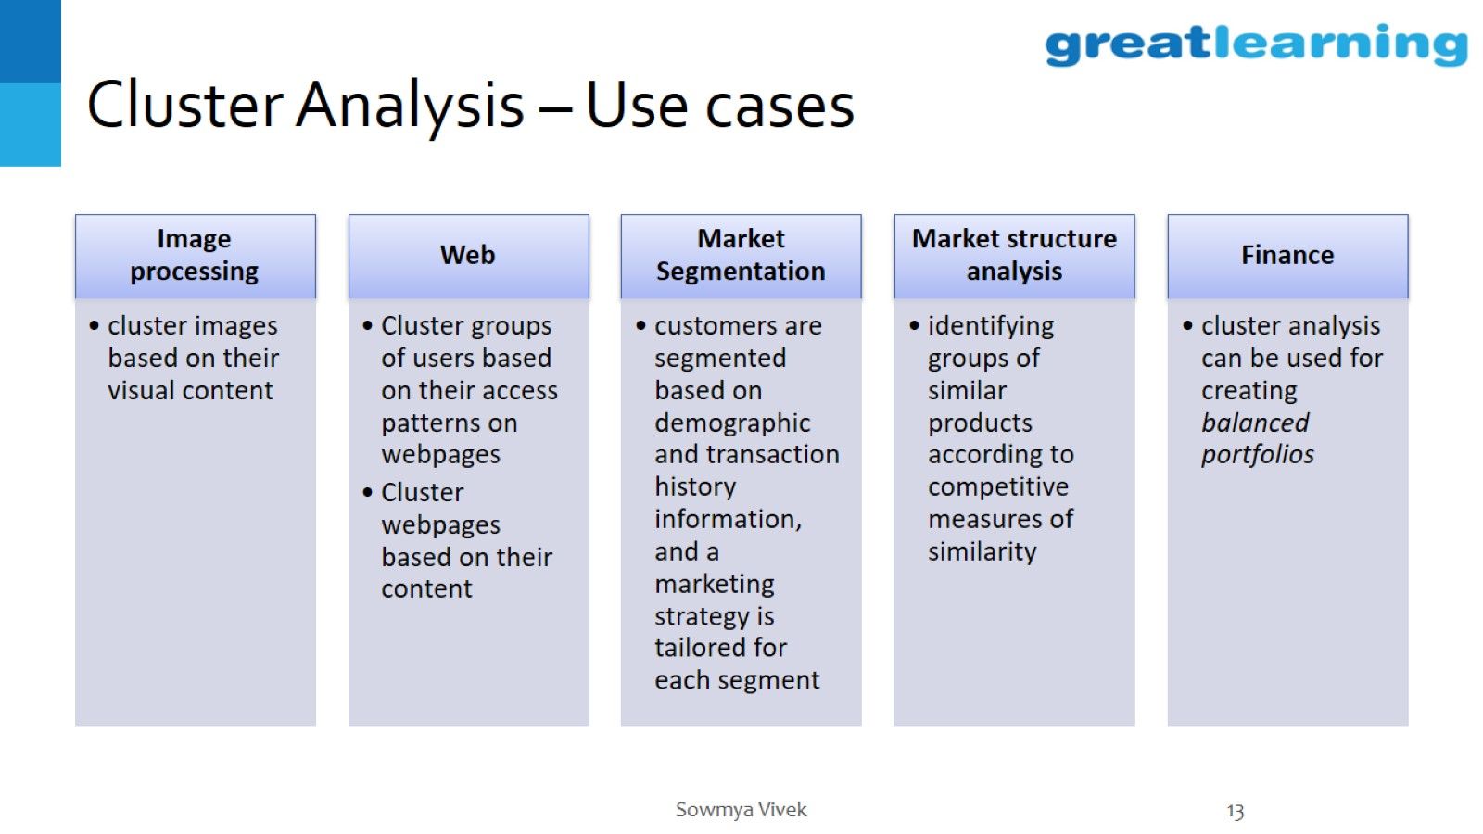
Cluster Analysis – Use cases

Slide 14
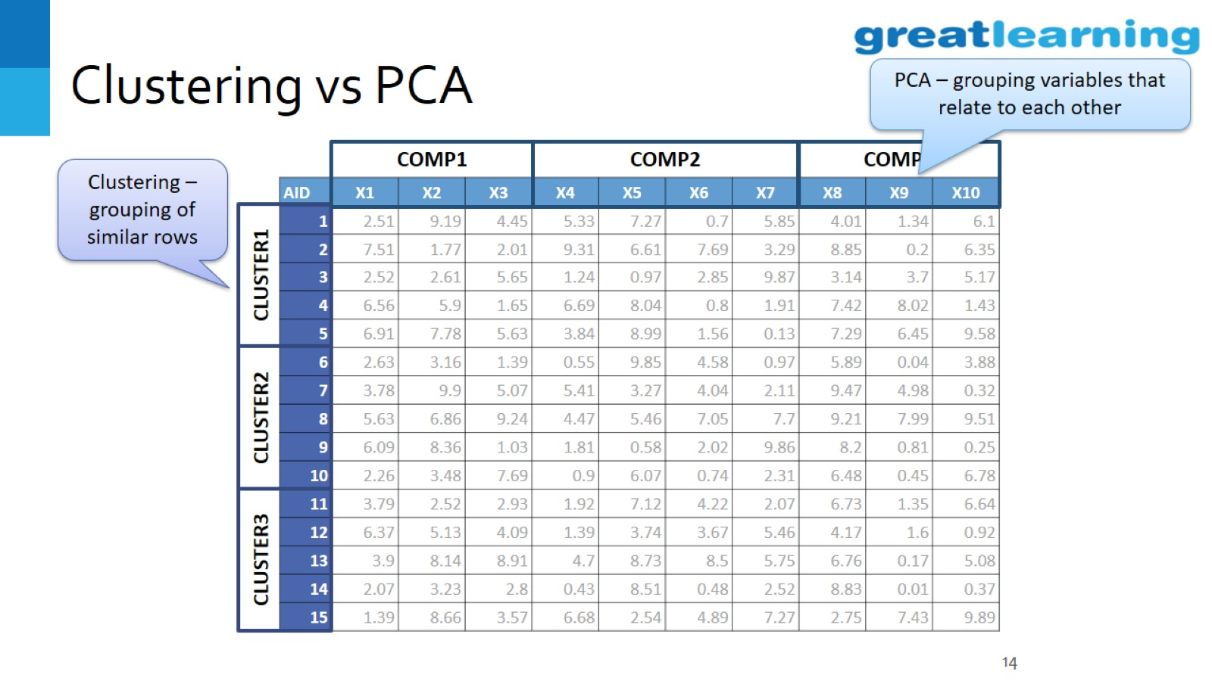
Clustering vs PCA

Slide 15
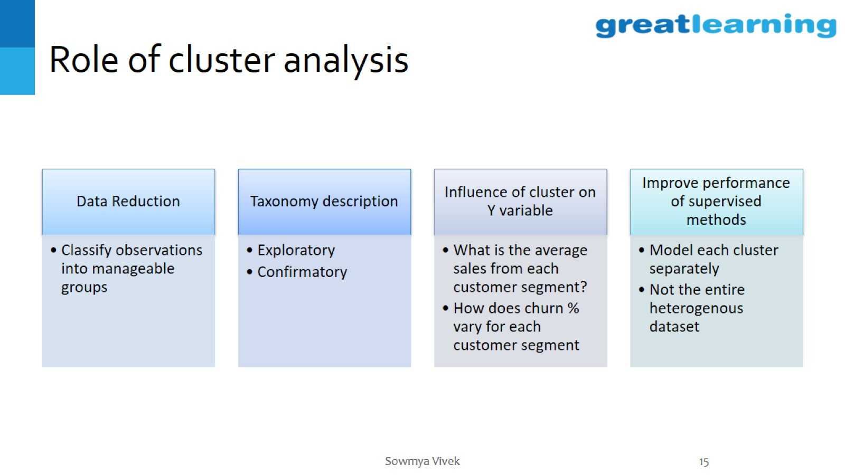
Role of cluster analysis

Slide 16
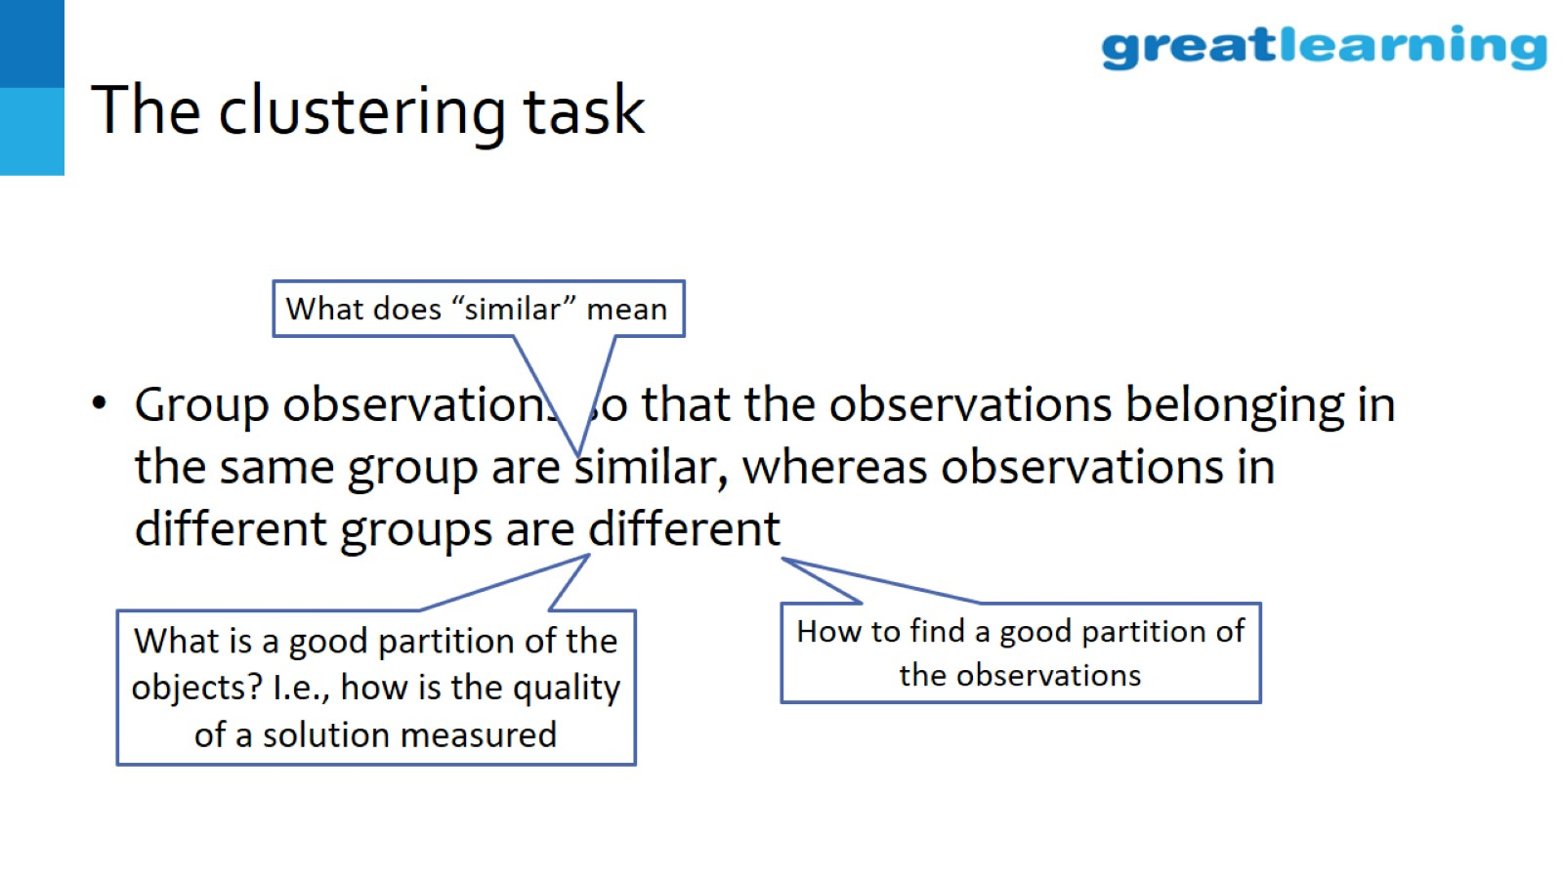
The clustering task

Slide 17
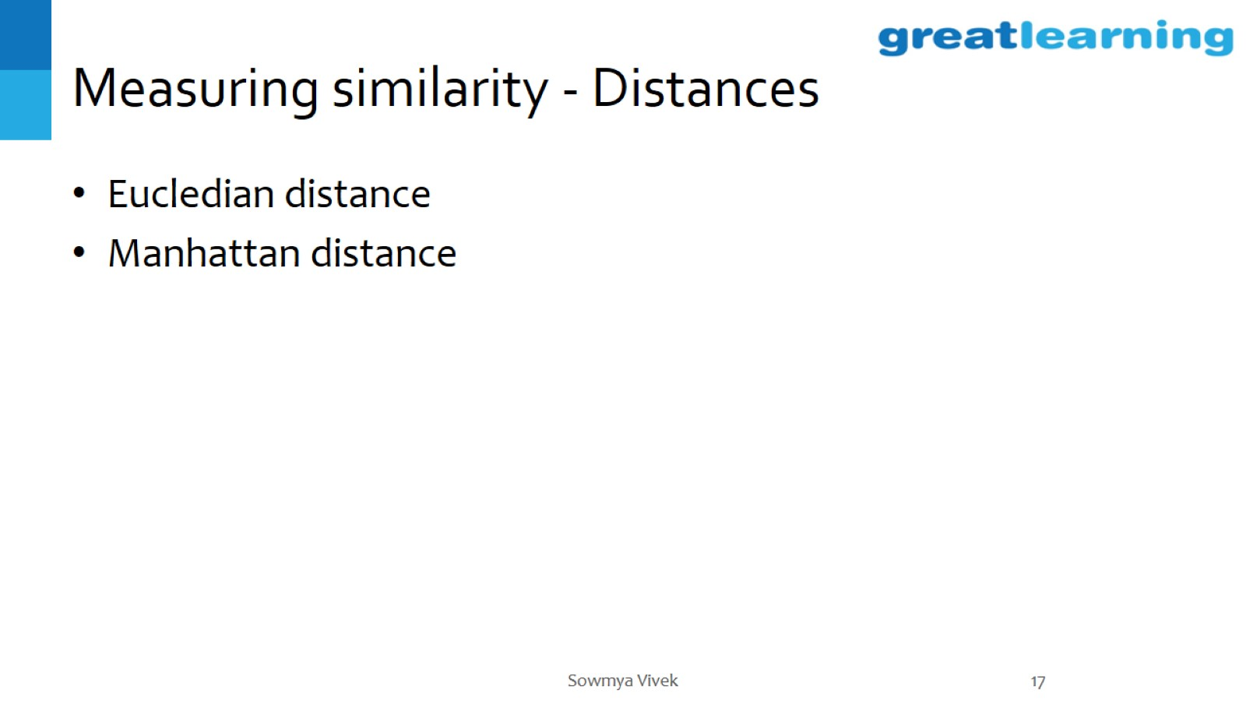
Measuring similarity - Distances

Slide 18
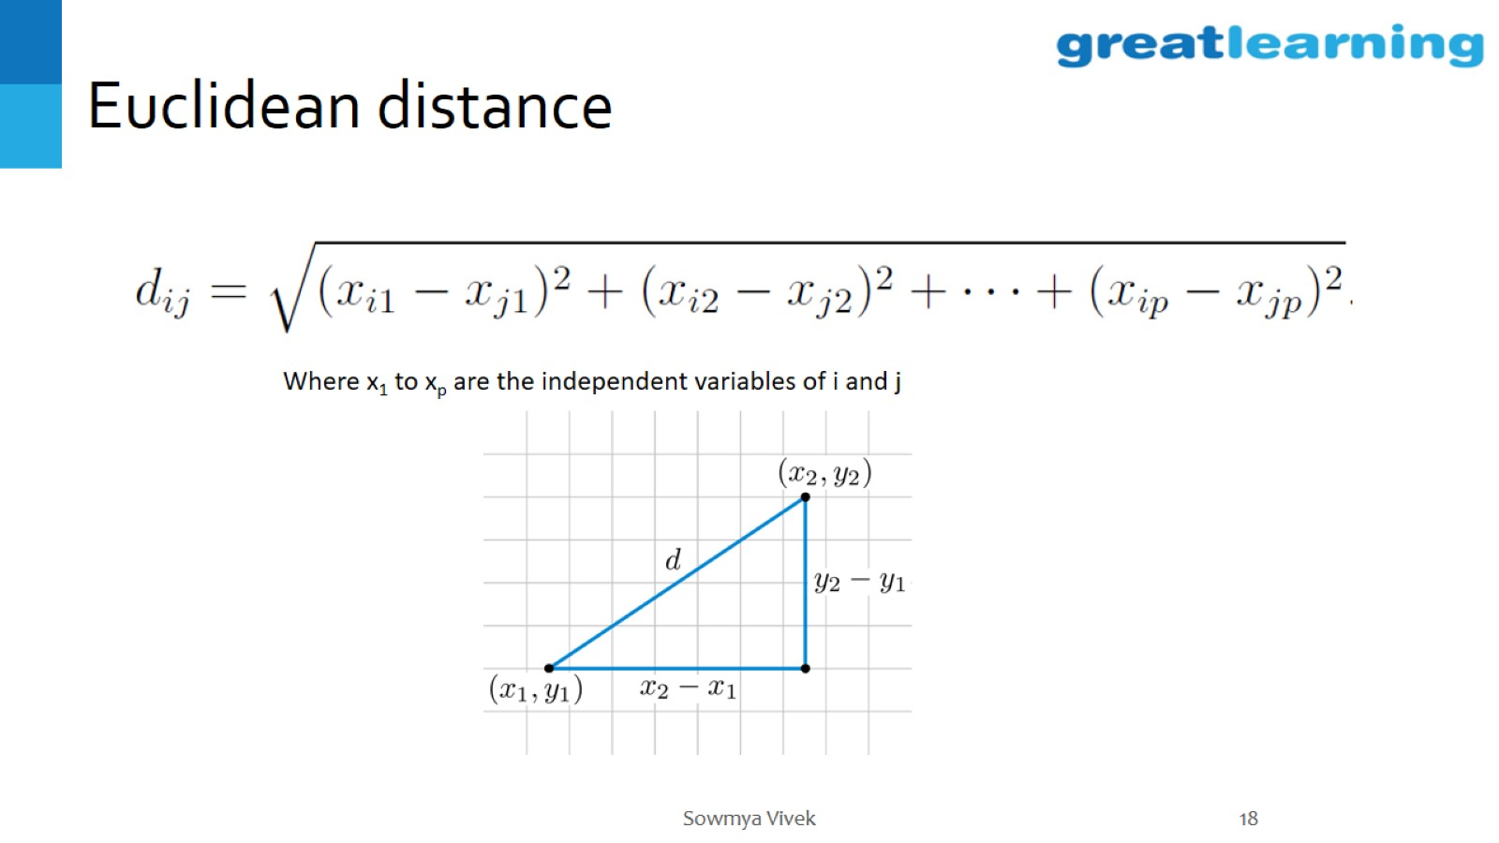
Euclidean distance

Slide 19
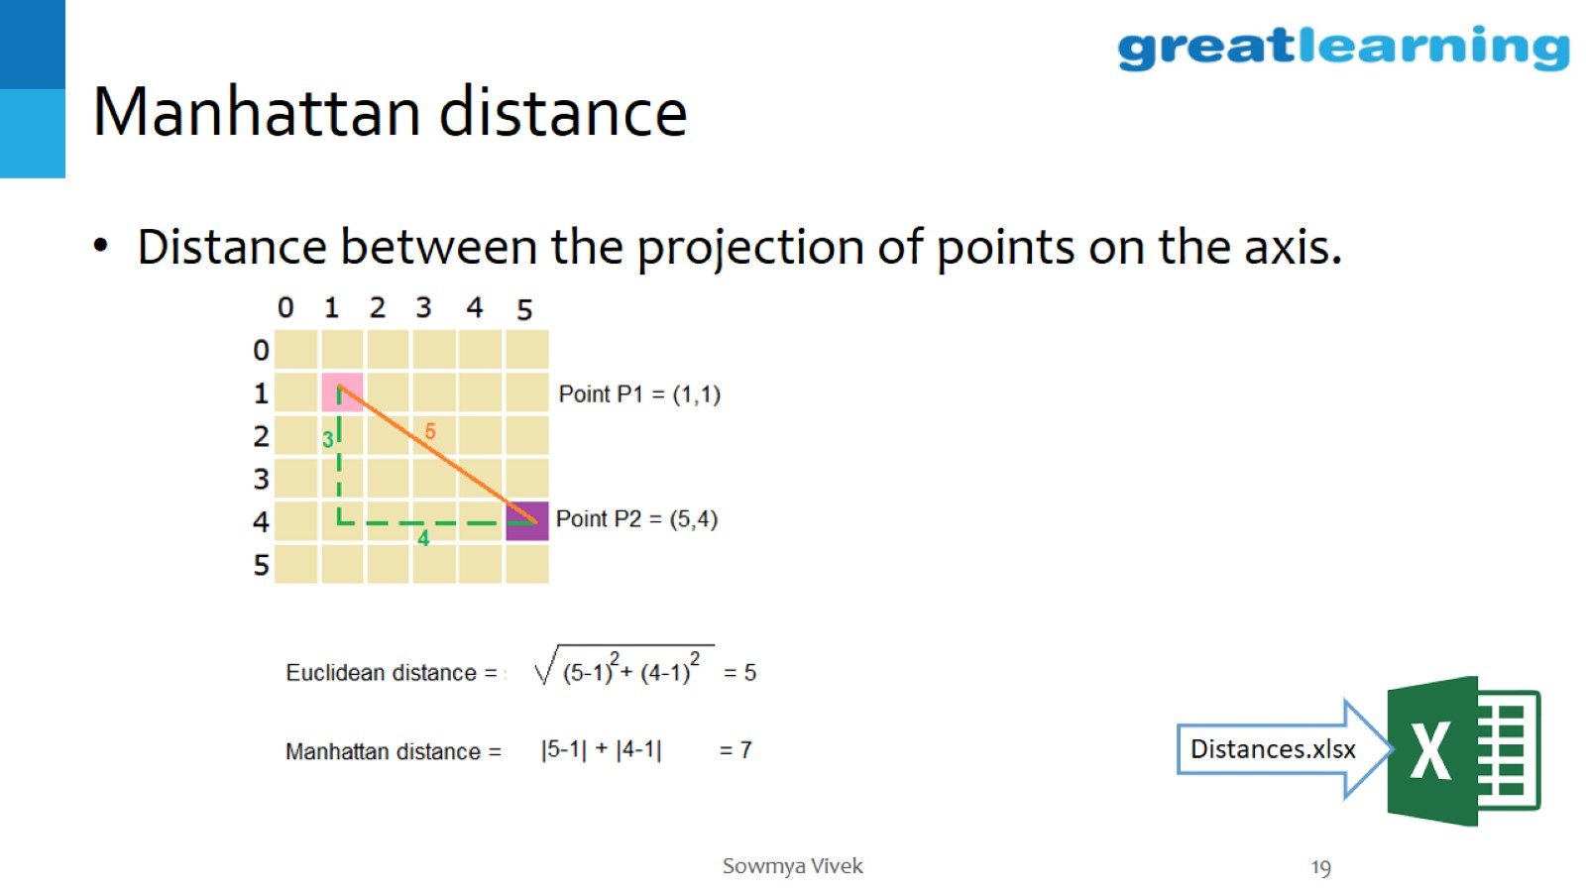
Manhattan distance

Slide 20
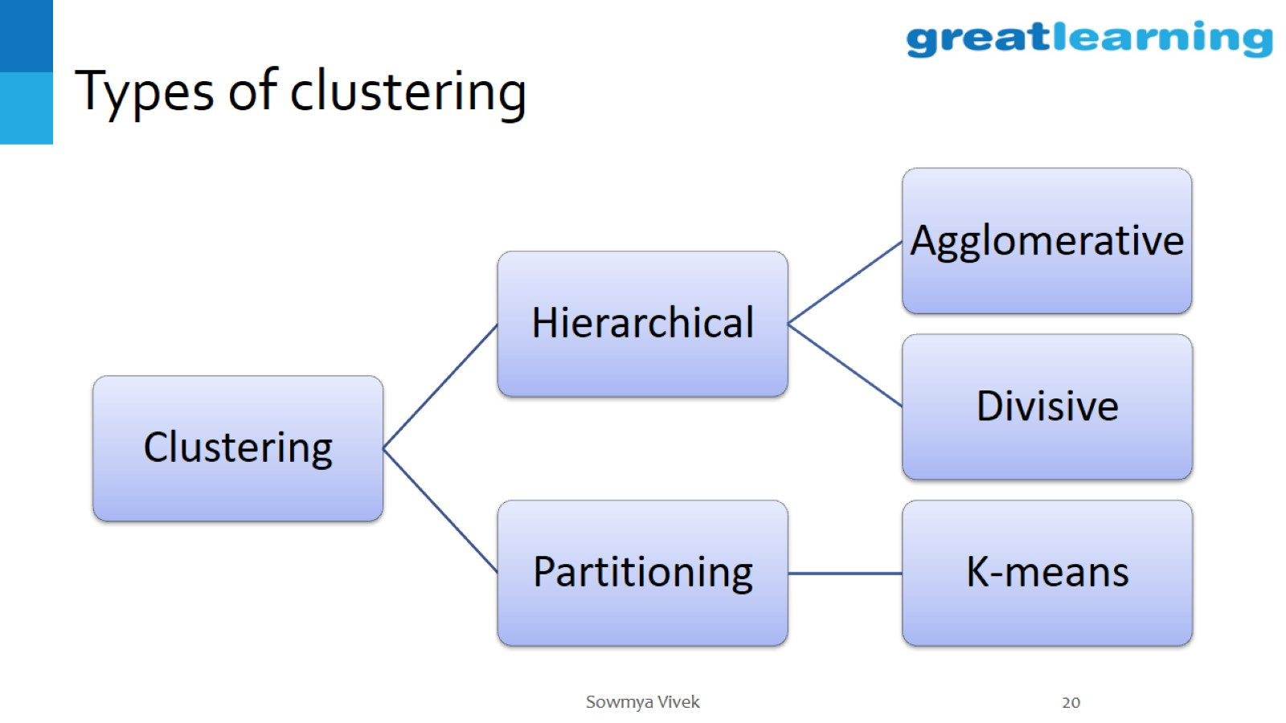
Types of clustering

Slide 21
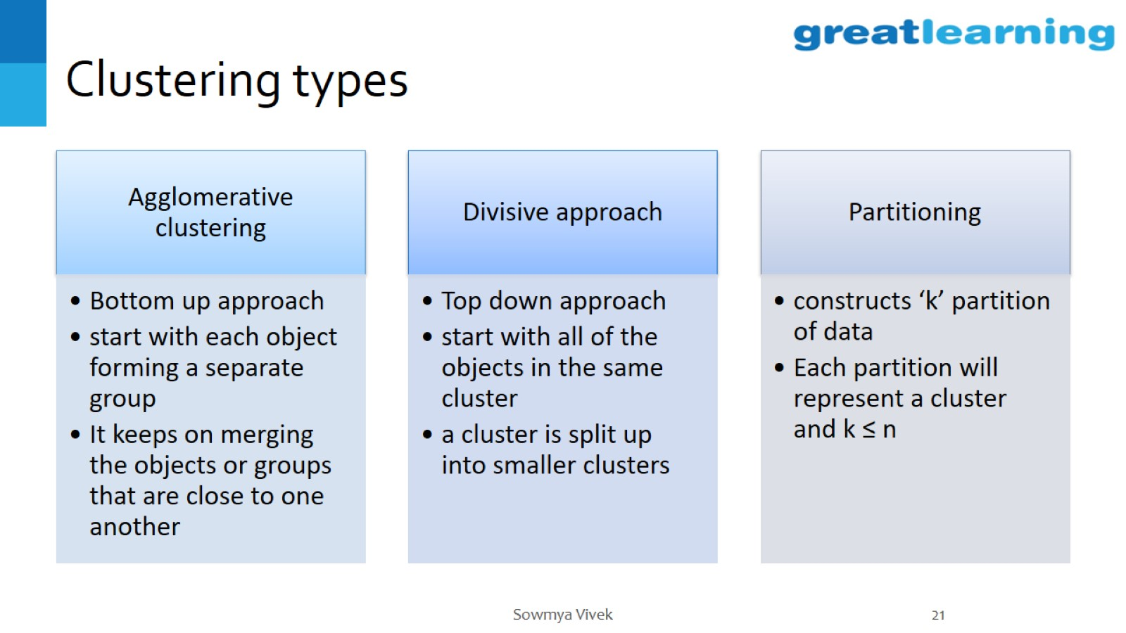
Clustering types

Slide 22
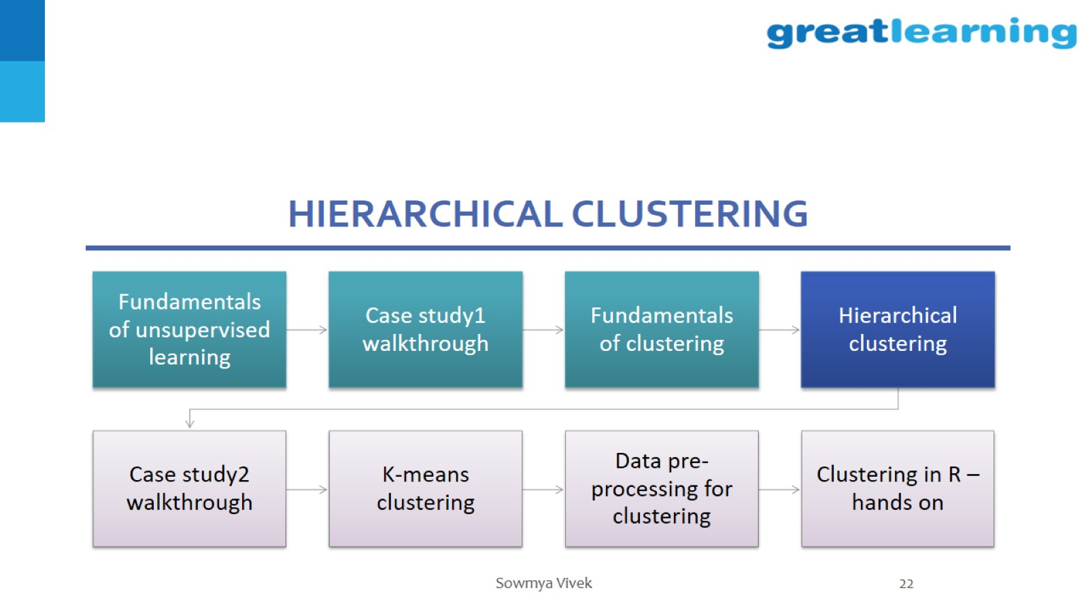
Hierarchical clustering

Slide 23
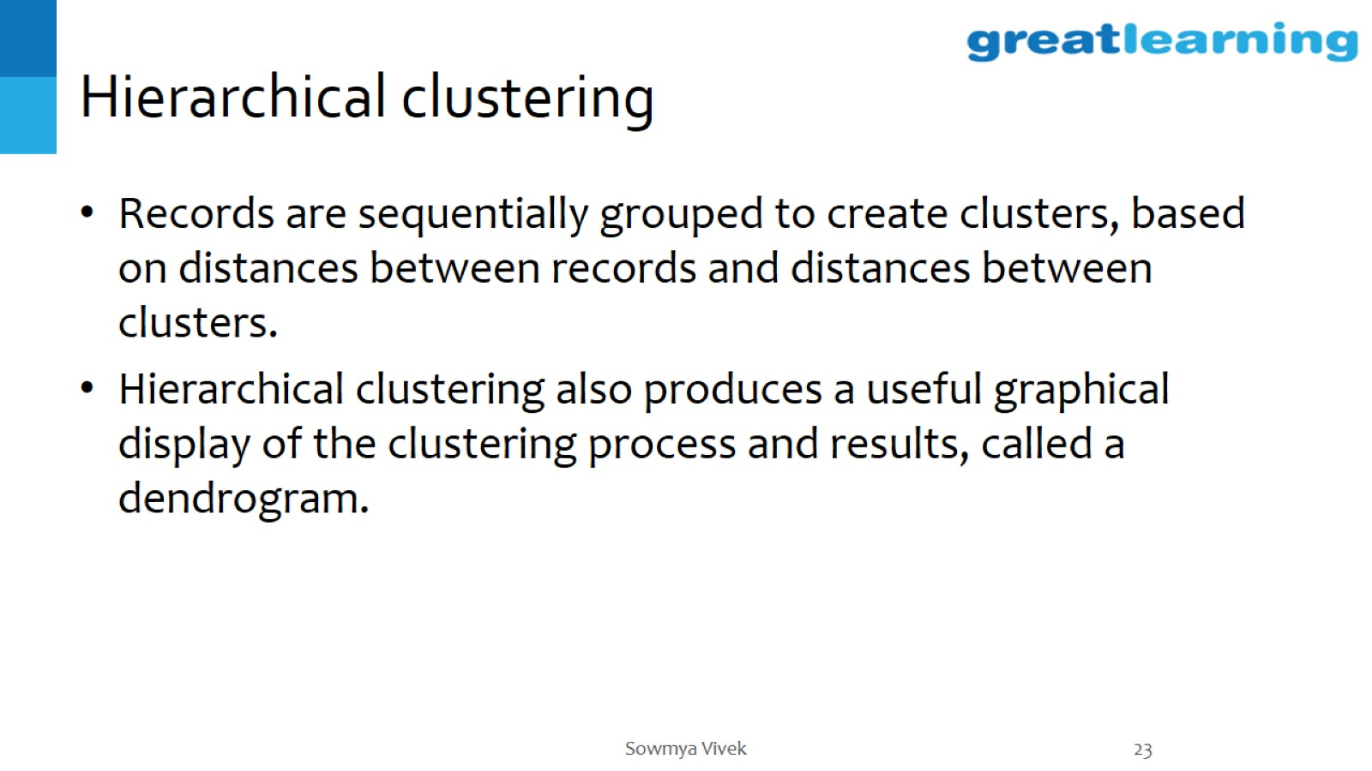
Hierarchical clustering

Slide 24
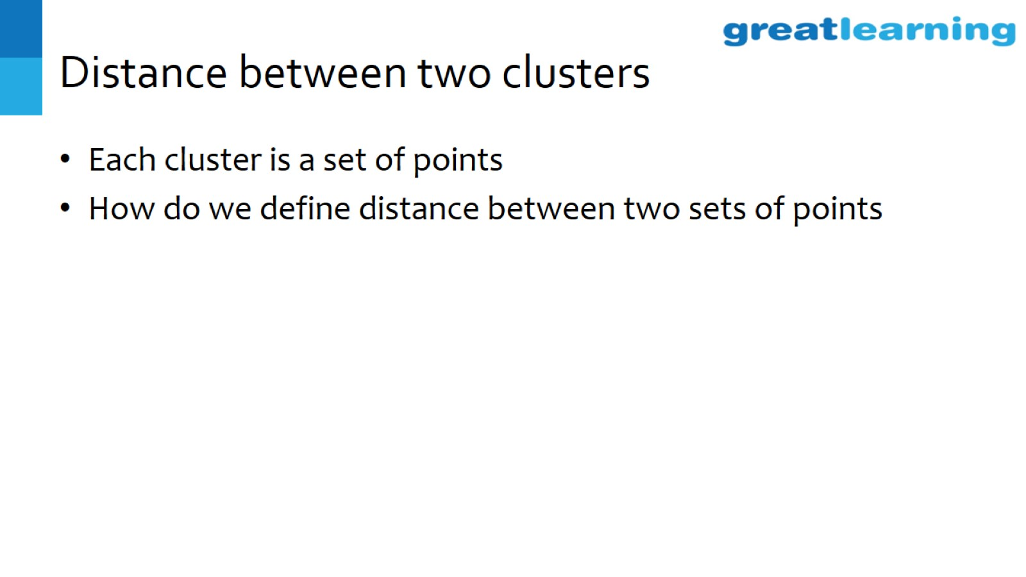
Distance between two clusters

Slide 25
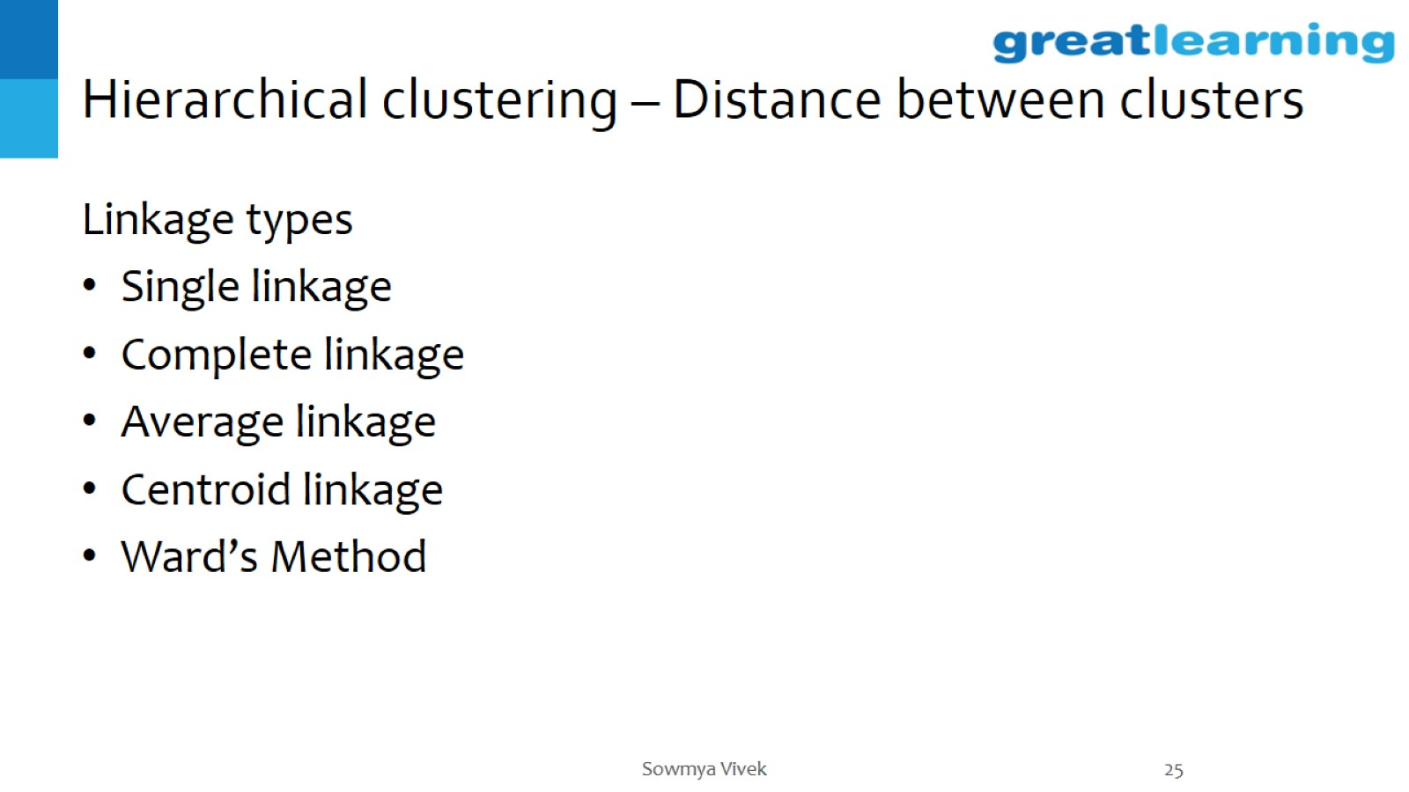
Hierarchical clustering – Distance between clusters

Slide 26
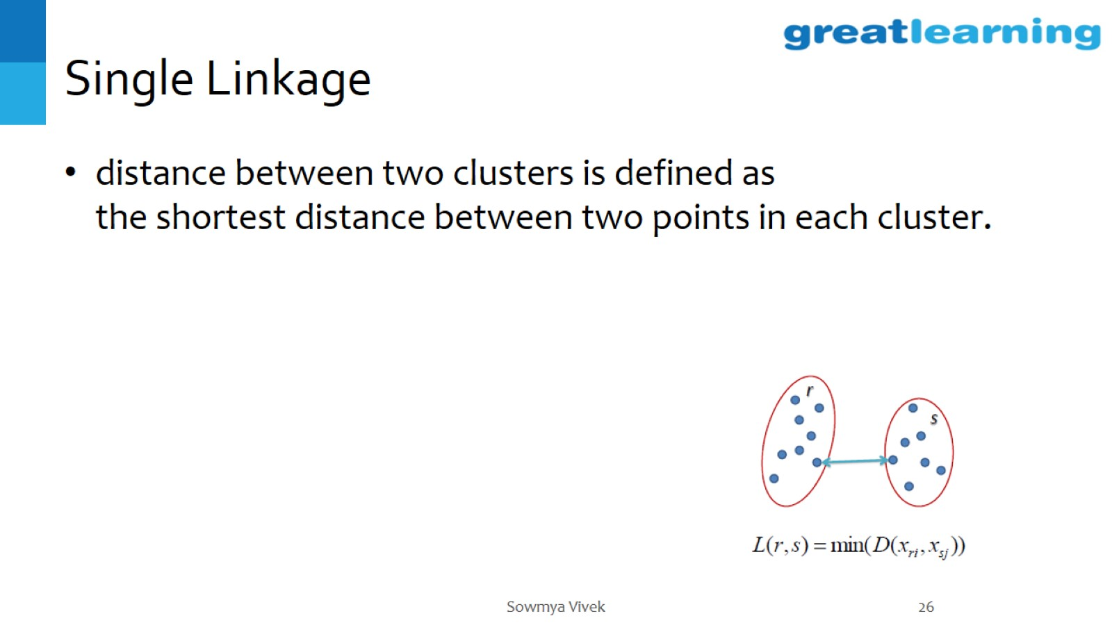
Single Linkage

Slide 27
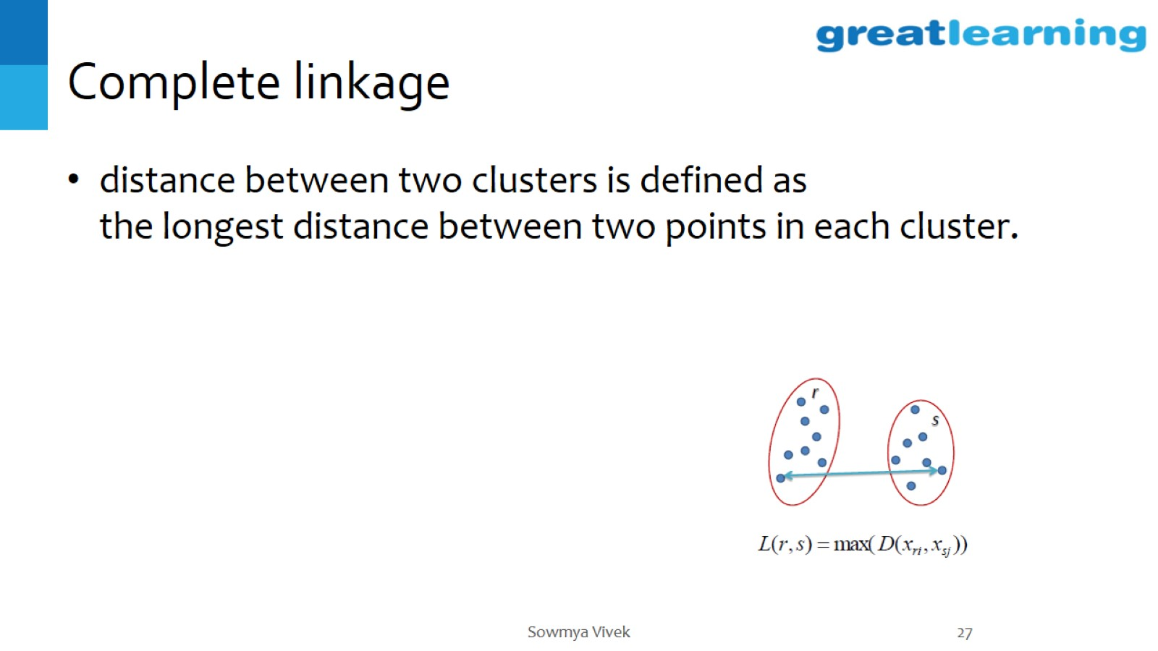
Complete linkage

Slide 28
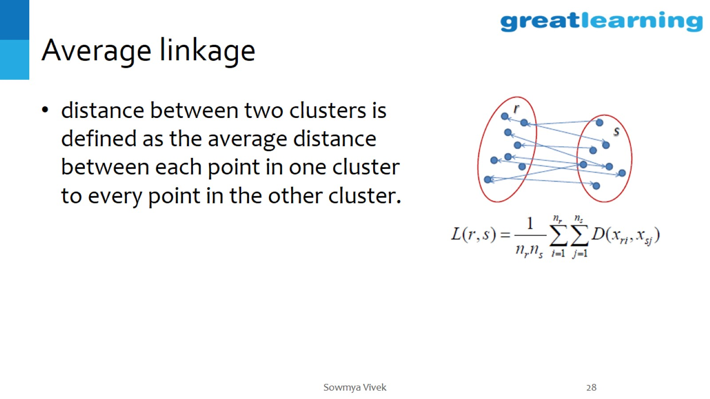
Average linkage

Slide 29
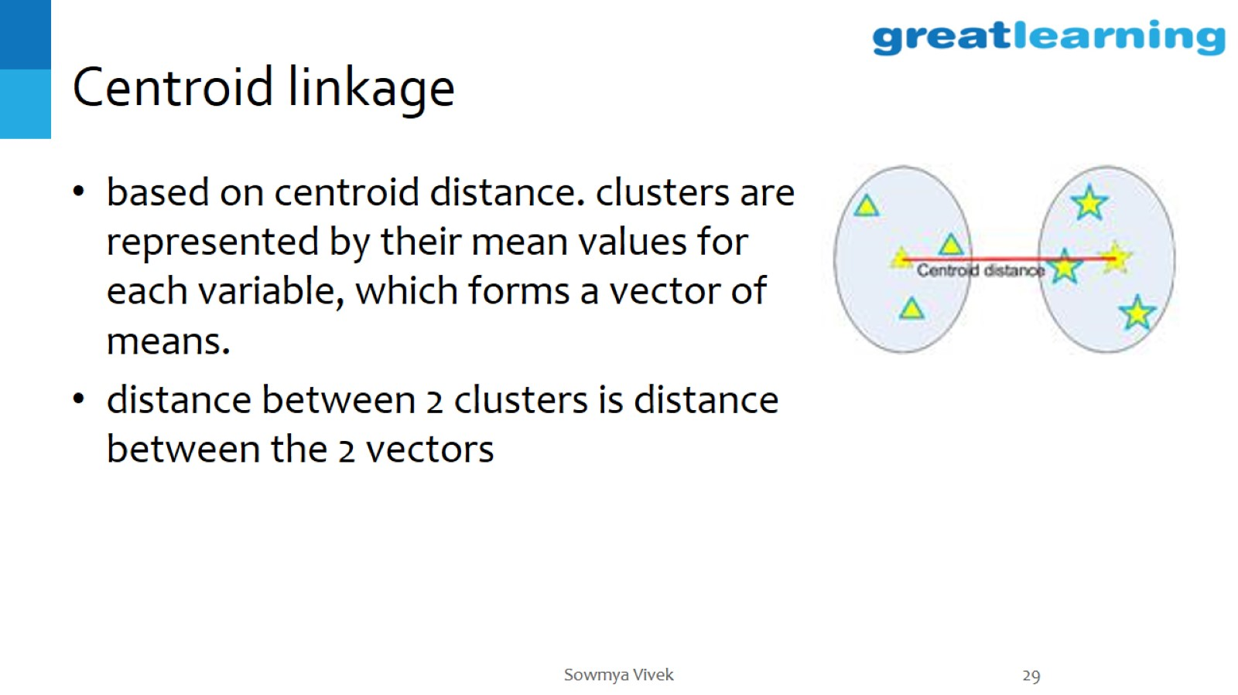
Centroid linkage

Slide 30
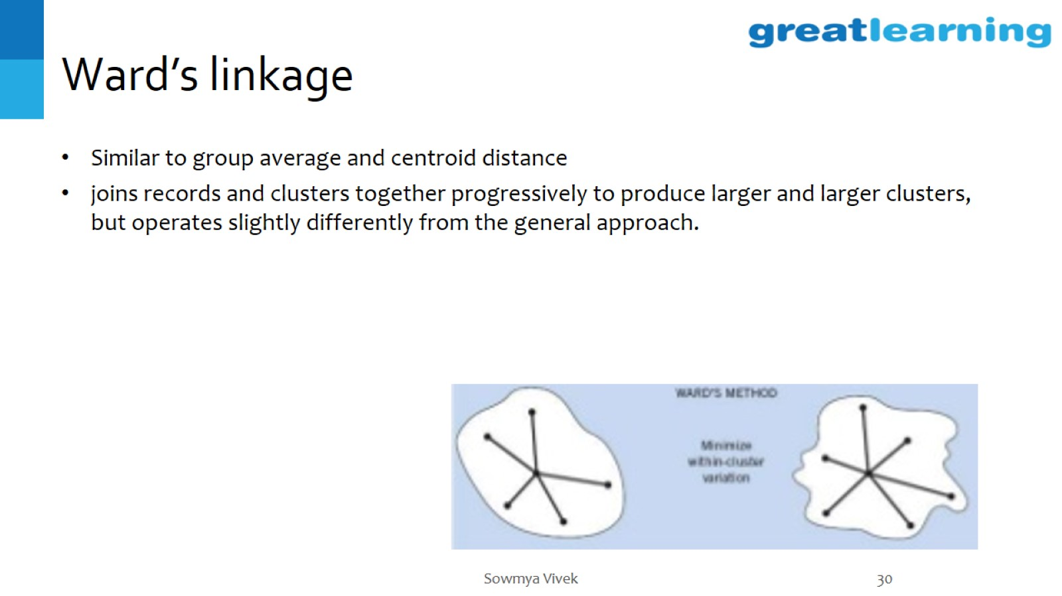
Ward’s linkage

Slide 31
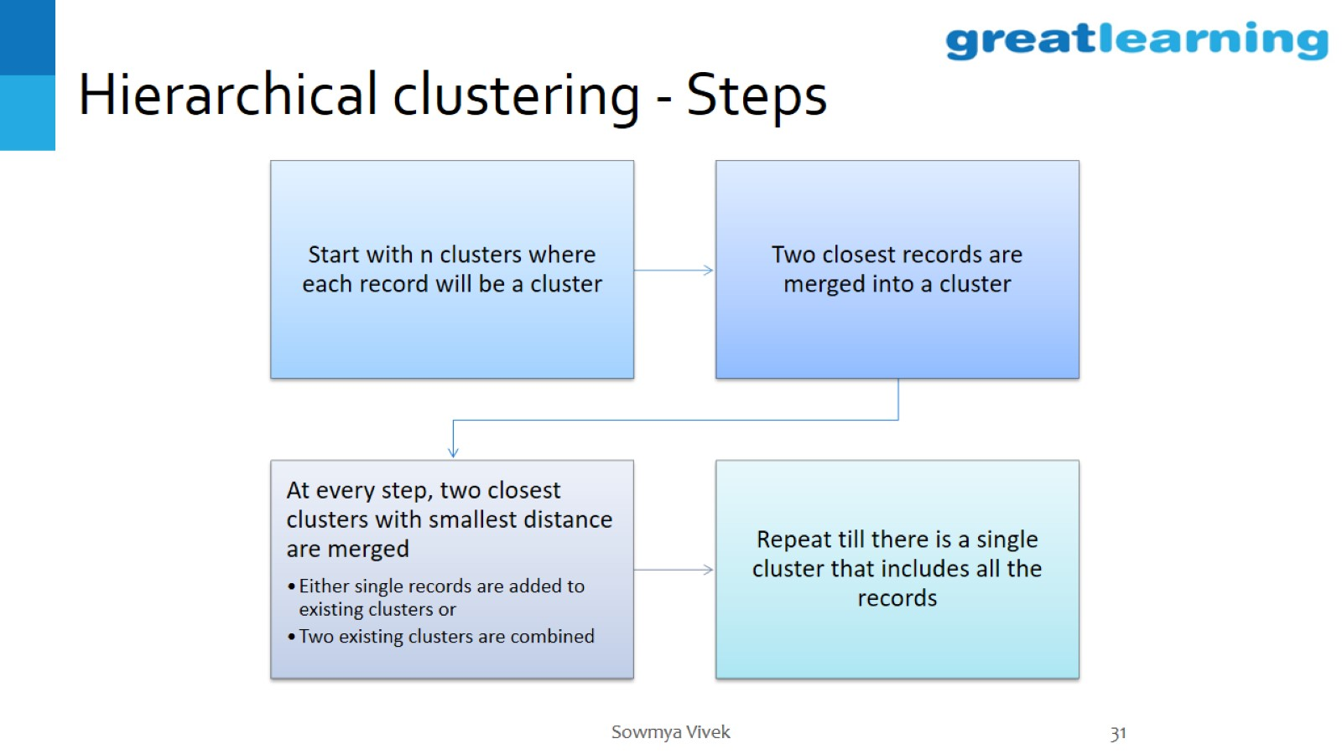
Hierarchical clustering - Steps

Slide 32
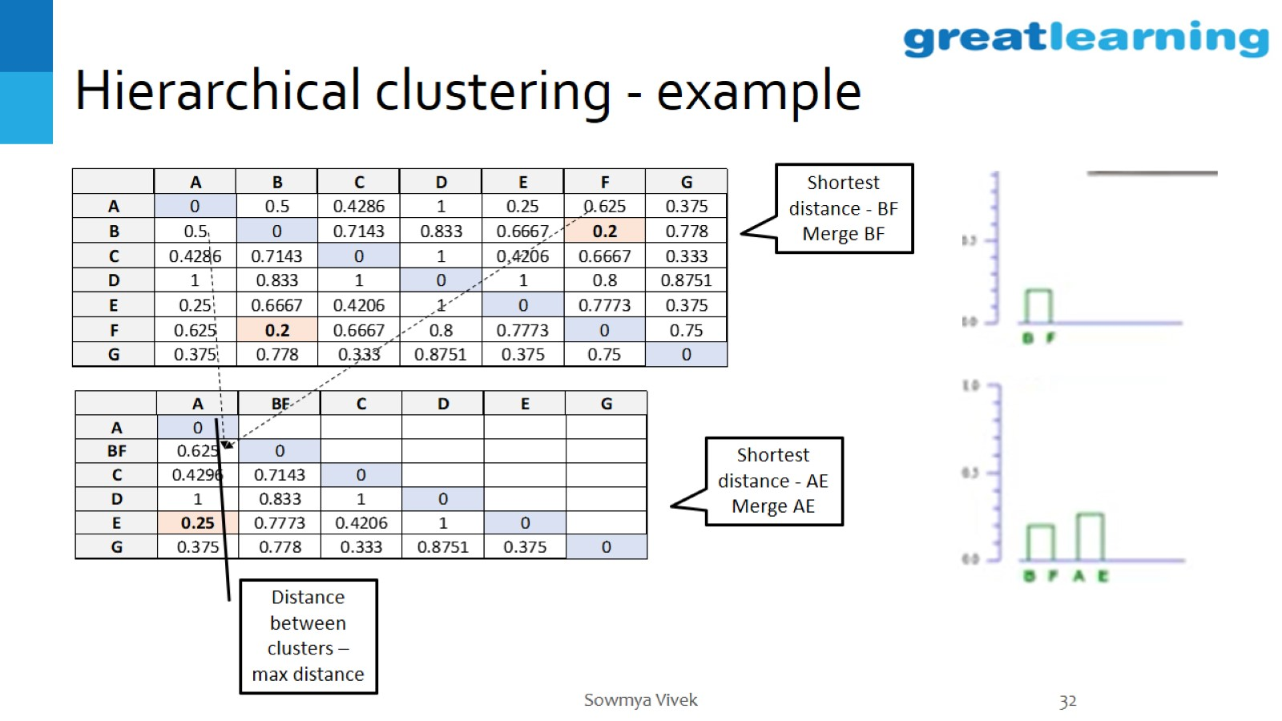
Hierarchical clustering - example

Slide 33
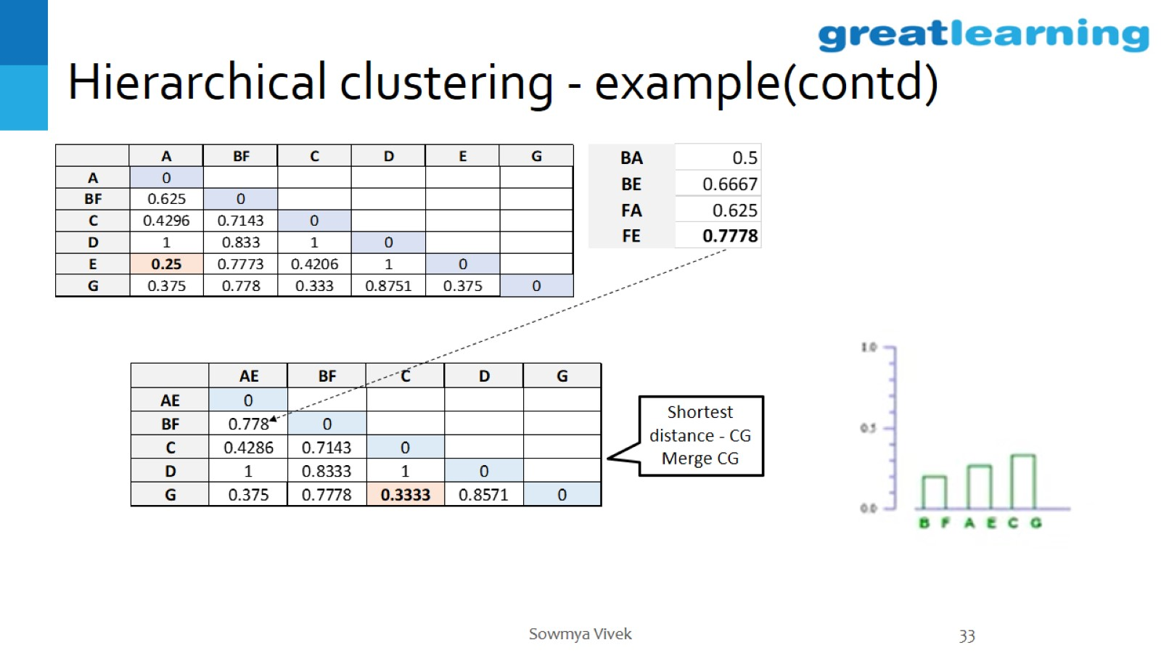
Hierarchical clustering - example(contd)

Slide 34
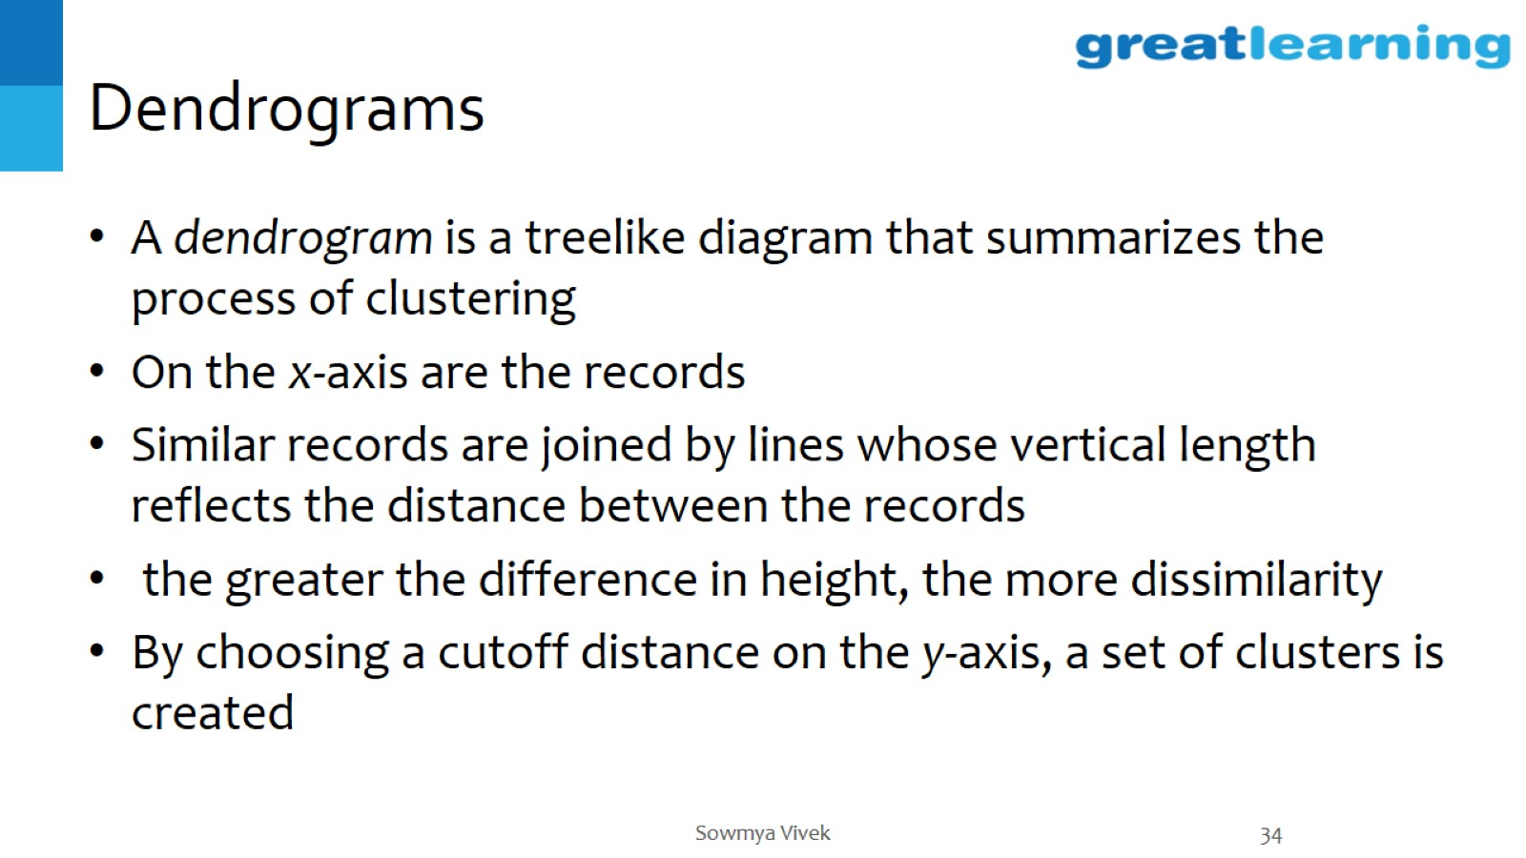
Dendrograms

Slide 35
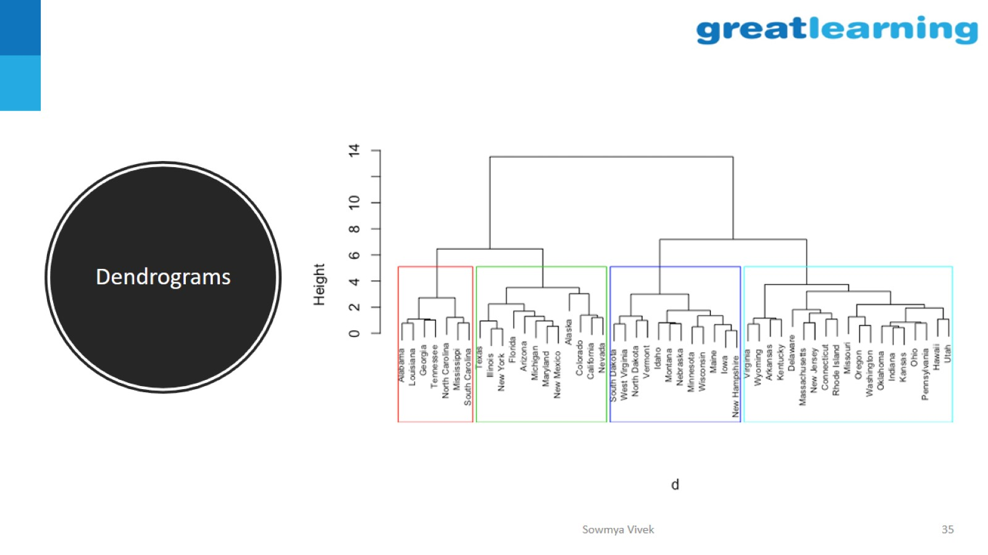
Dendrograms

Slide 36
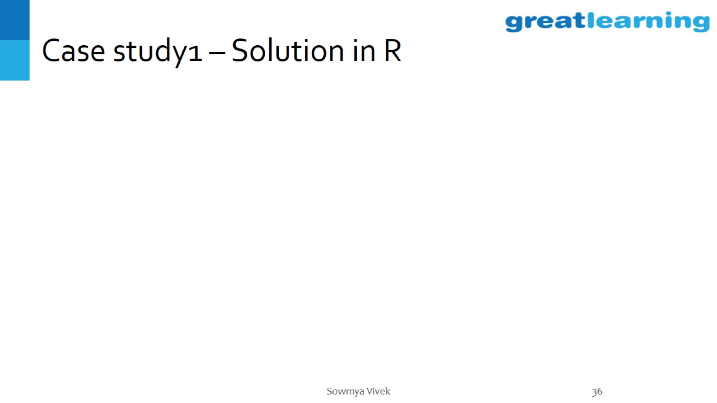
Case study1 – Solution in R

Slide 37
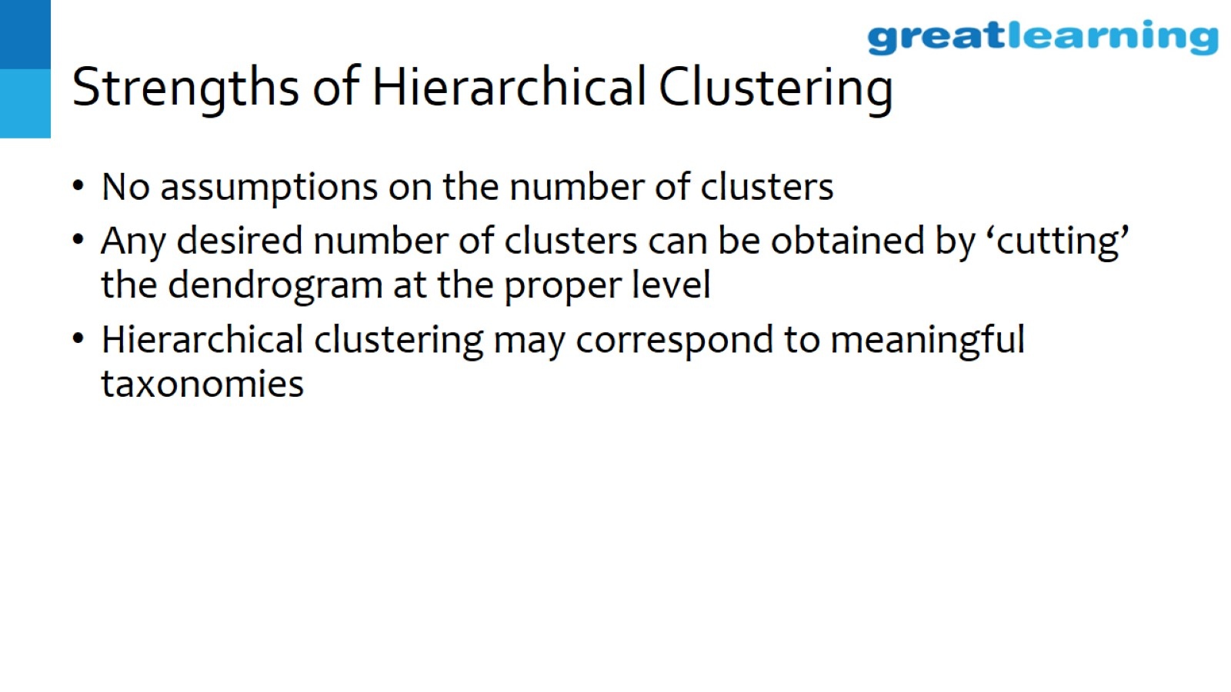
Strengths of Hierarchical Clustering

Slide 38
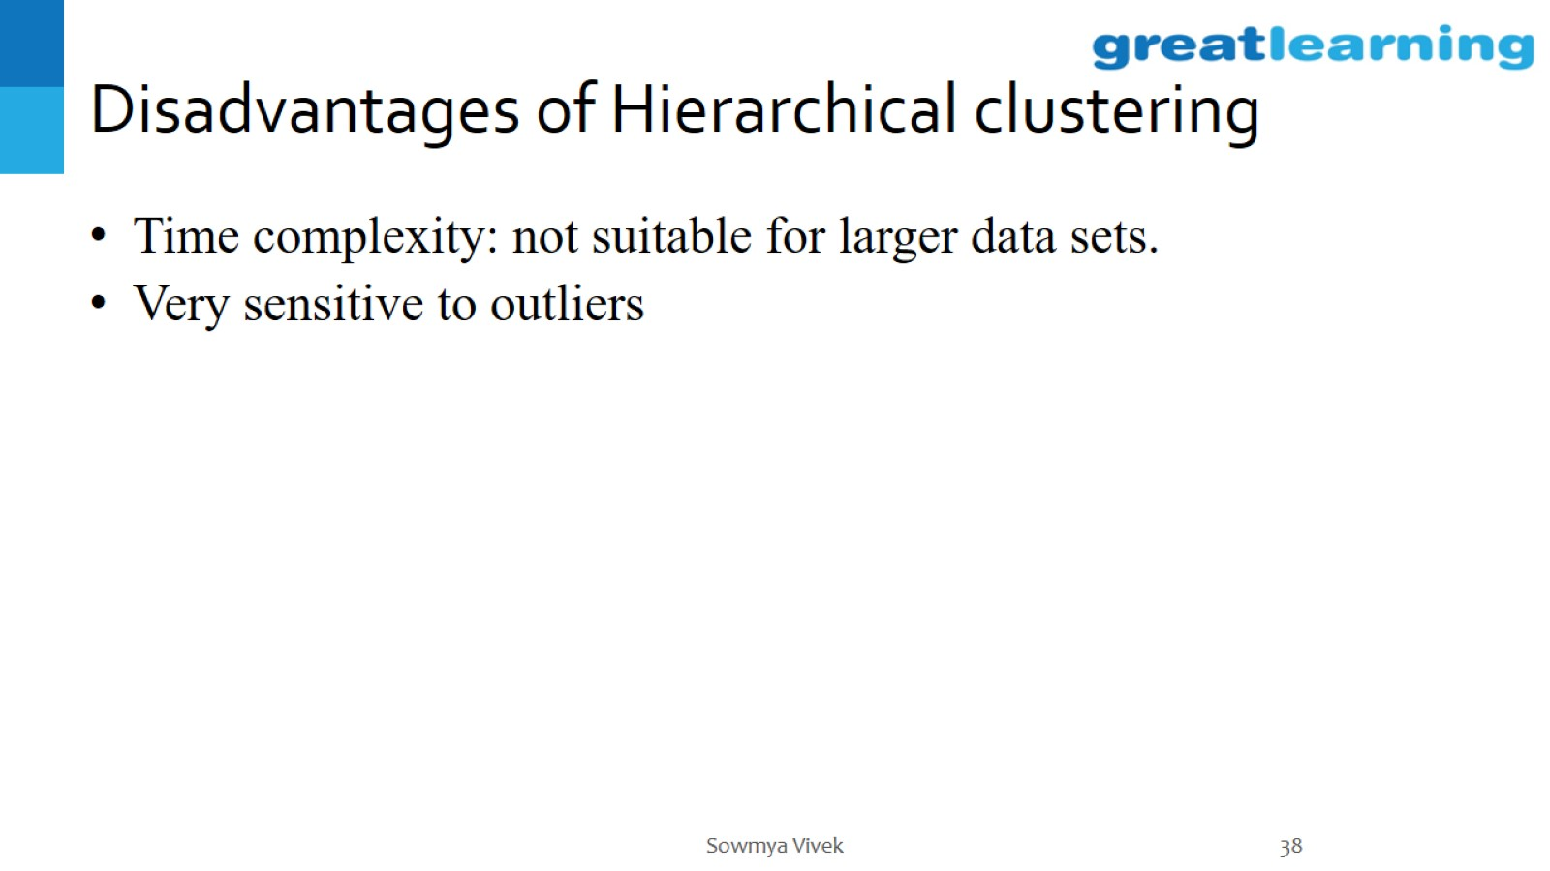
Disadvantages of Hierarchical clustering

Slide 39
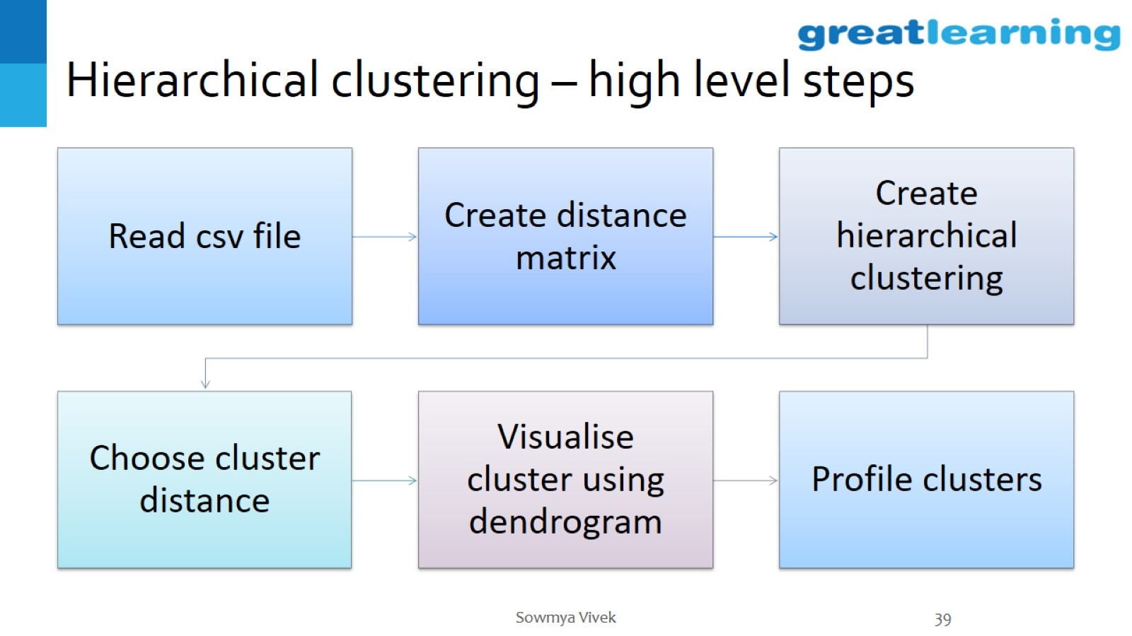
Hierarchical clustering – high level steps

Slide 40
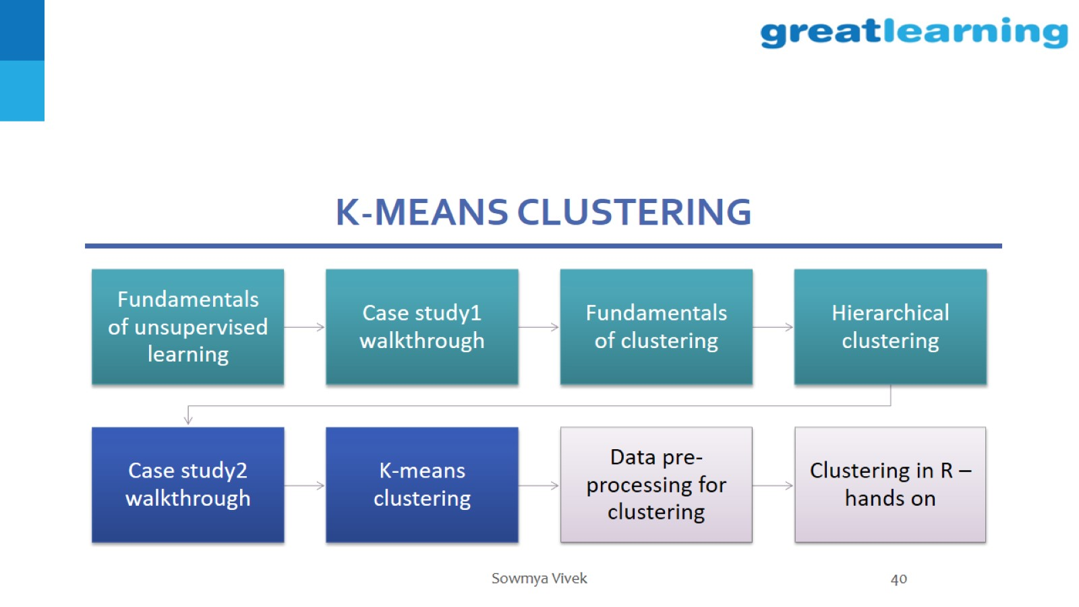
K-means clustering

Slide 41
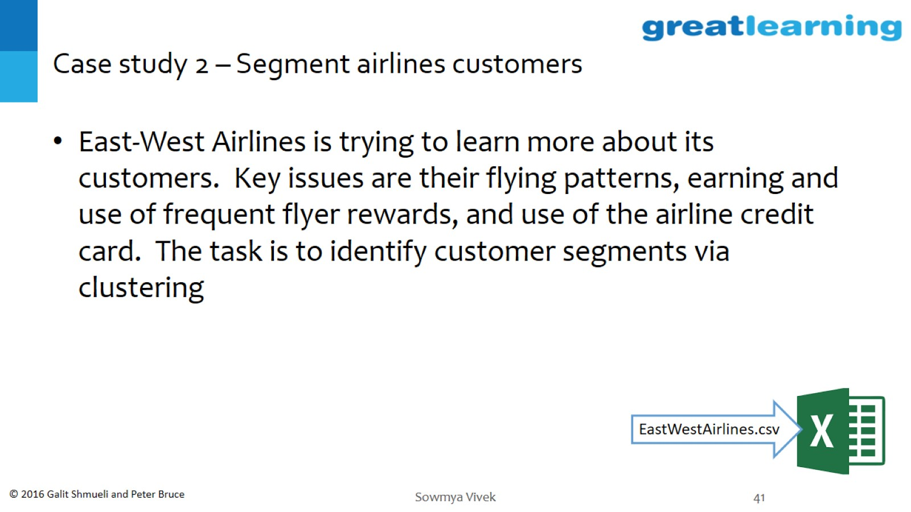
Case study 2 – Segment airlines customers

Slide 42
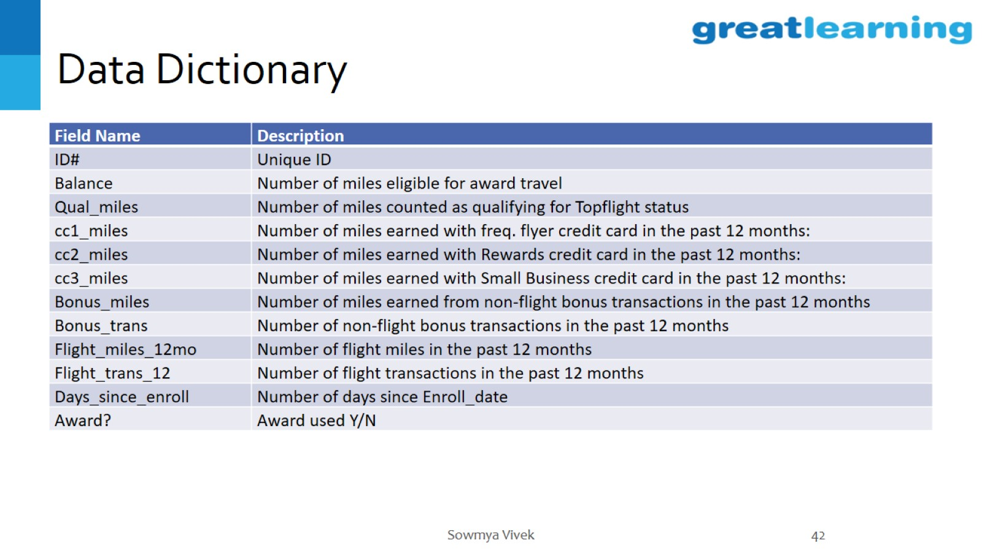
Data Dictionary

Slide 43
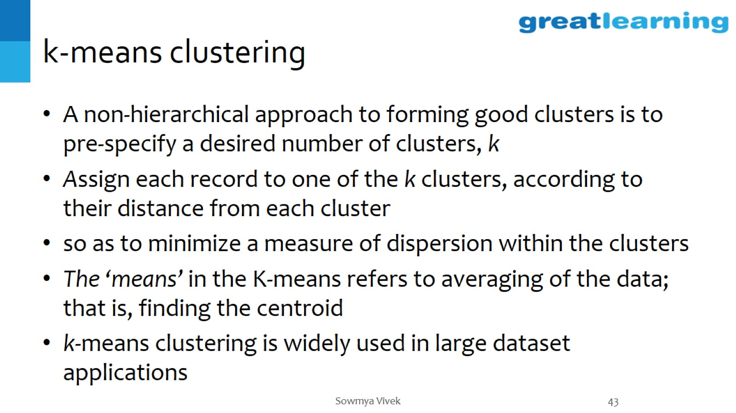
k-means clustering

Slide 44
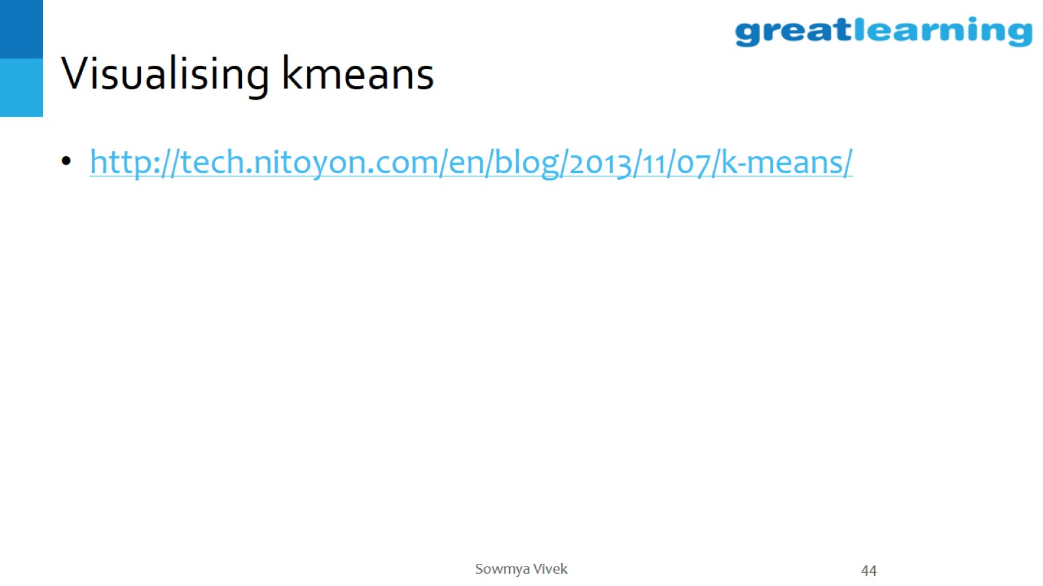
Visualising kmeans

Slide 45
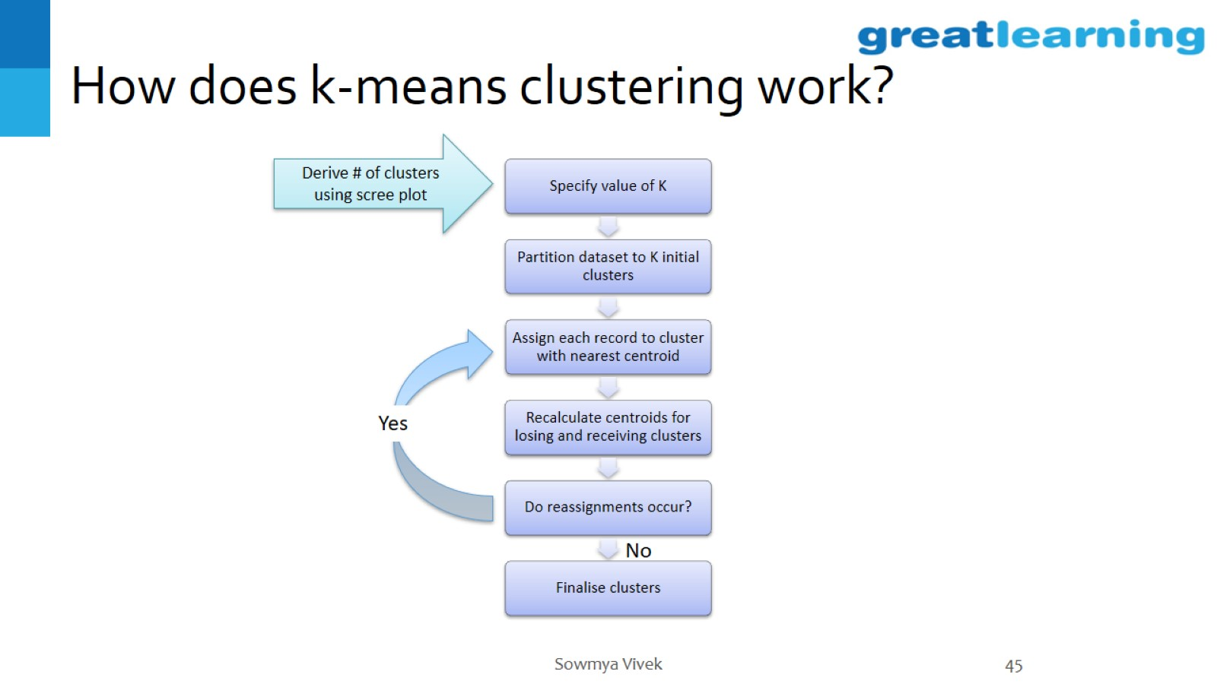
How does k-means clustering work?

Slide 46
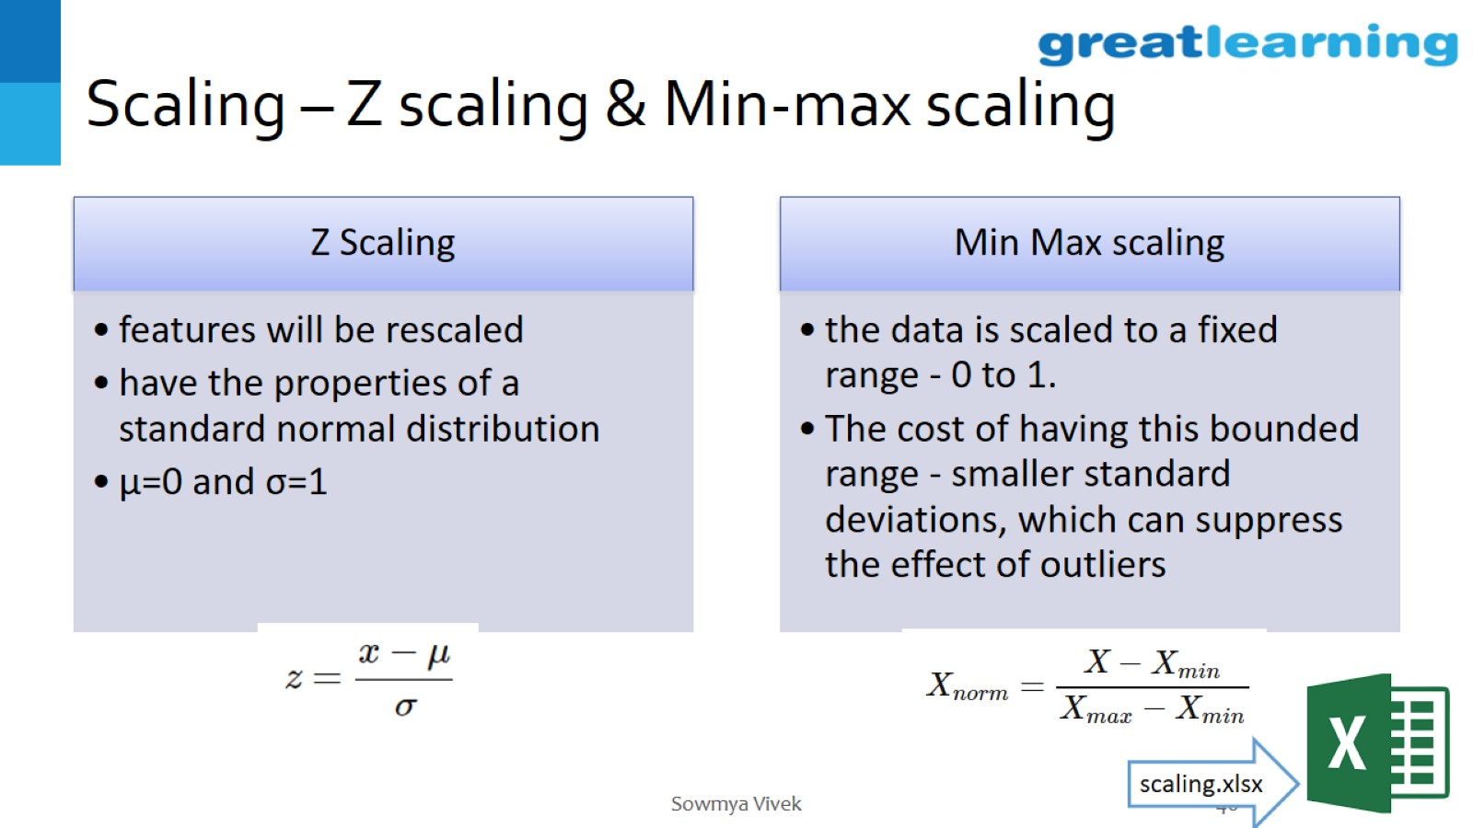
Scaling – Z scaling & Min-max scaling

Slide 47
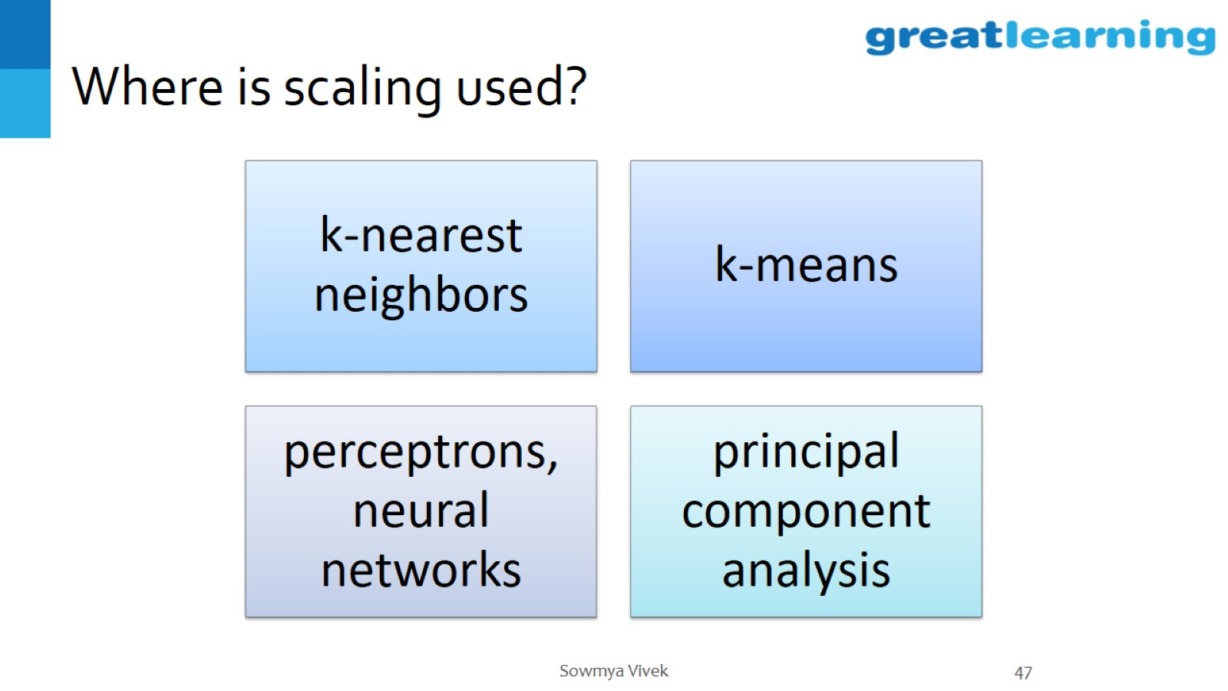
Where is scaling used?

Slide 48
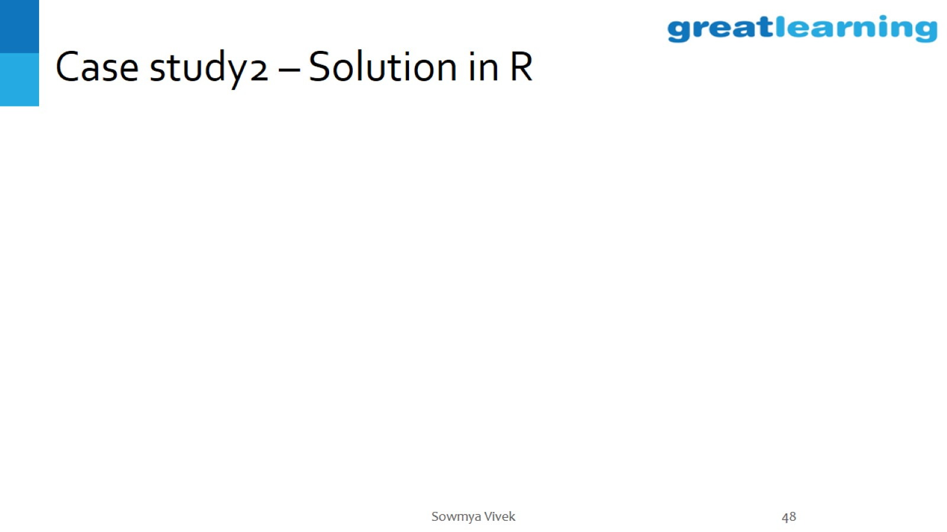
Case study2 – Solution in R

Slide 49
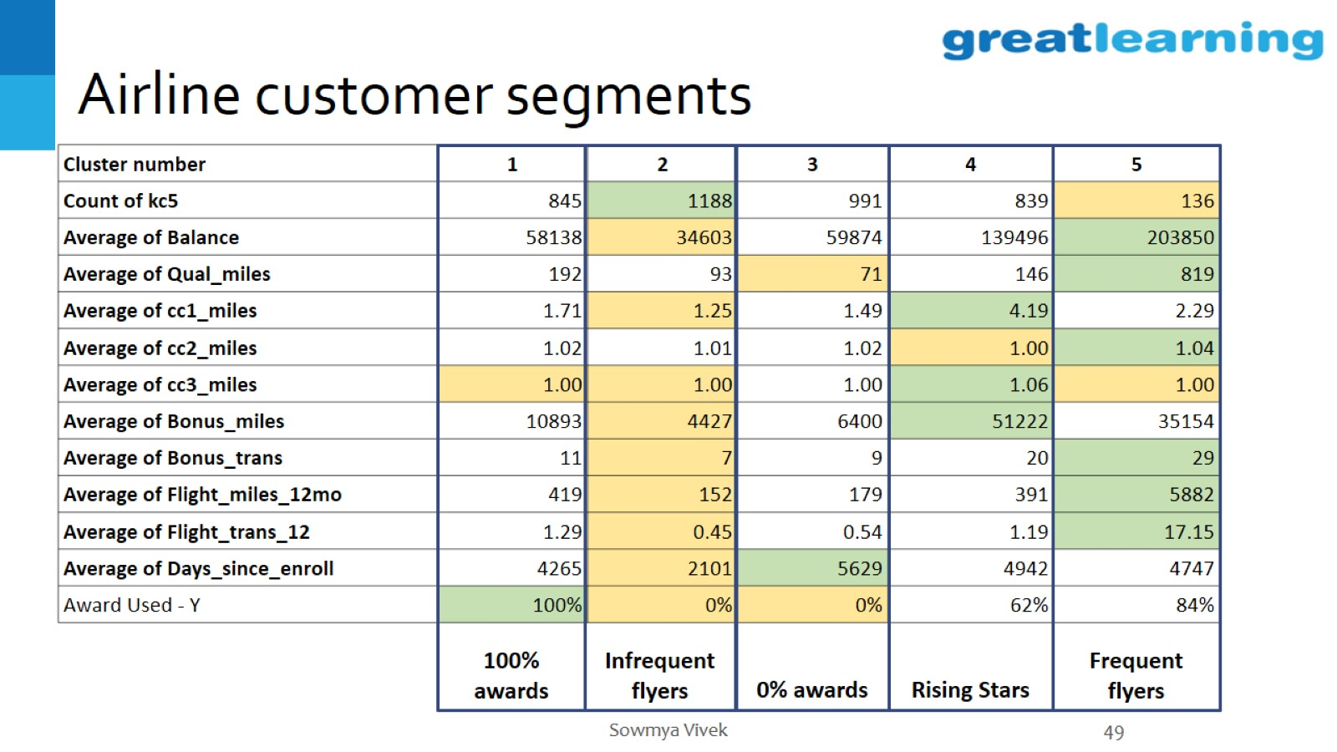
Airline customer segments

Slide 50
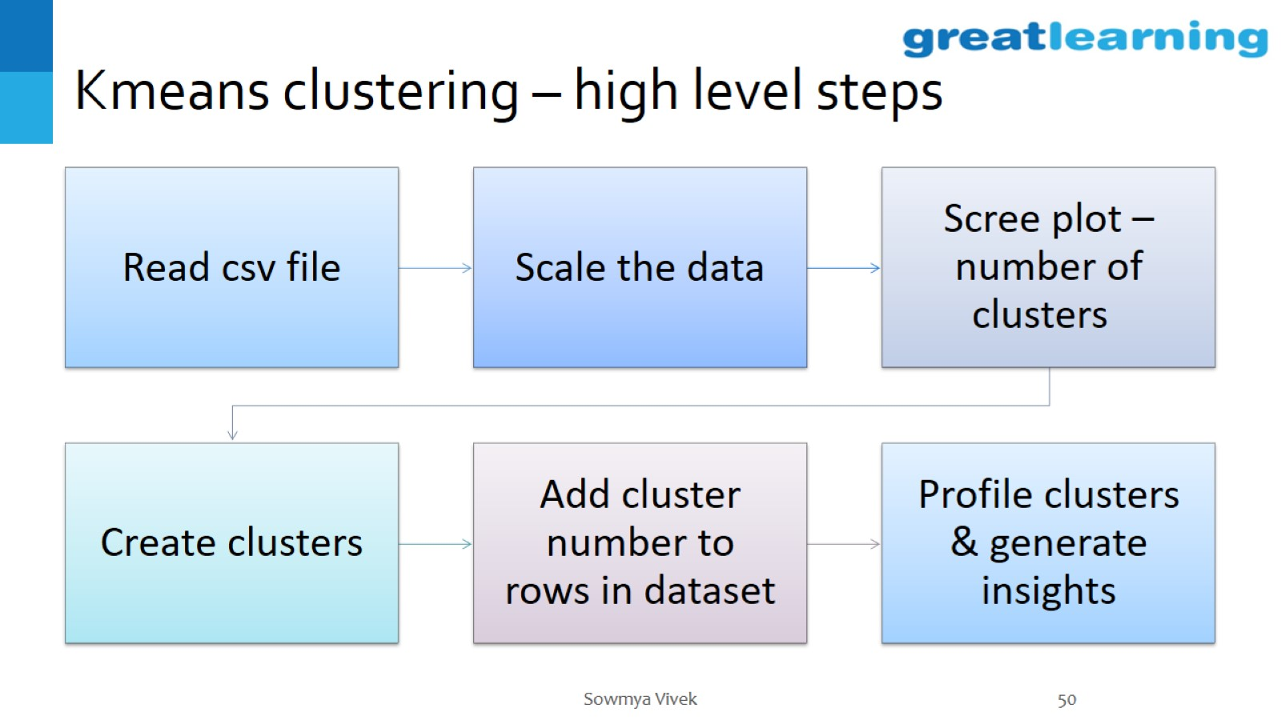
Kmeans clustering – high level steps

Slide 51

Practical considerations

Slide 52

Validating Clusters

Slide 53


